Slide 1
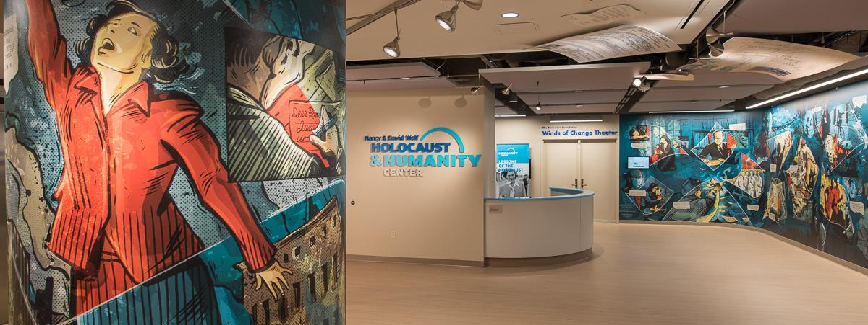
360 VIRTUAL TOUR & ACTIVITY

Slide 2
360 Tour & Activity
This activity has questions, testimony & audio clips from the museum that work with HHC’s 360 Tour. Each question is linked to a section of the museum. Students can take the tour before or after completing this activity, OR this activity can stand alone without the tour.
Students who take the 360 Tour can click on the thumbnails at the bottom of the screen, or they can move around to see the exhibits.
The tour has 20 highlights you can explore by clicking an outlined circle in the exhibit as you move around the museum.

Slide 3
Introduction
Listen to the introduction to the tour audio clip.
What did you learn about Union Terminal?
Look at the sculptures in the concourse. Who do you think they are made to represent?

Slide 4
Lobby Mural
Listen to an audio clip about the mural.
Why do you think HHC created the mural in the style of a graphic novel?
What did you learn about Stephanie from her mural segment?

Slide 5
Winds of Change Theater
Watch the clip of the orientation Film.
What did you learn about Stephanie Marks and her family?
What do the survivors at the end of the film ask you to do?

Slide 6
Mosaic
It is important that we understand the vibrancy and diversity of Jewish life before the war, and that we individualize the number six million. It is vital that we do not start the history of the Holocaust through the eyes of the perpetrators & antisemites.
What do you know about Jewish life in Europe prior to WWII?
Look at this photograph. What is HHC trying to tell you about Jewish life?
What would you like to know?

Slide 7
Power
“The Holocaust did not start with bullets, it started with words.” Al Miller
What do you think the quote means?
Listen to the audio clip.
What happened to Jews during the rise of Nazism?

Slide 8
Violence
Listen to the audio clip.
What happened on November 9-10, 1938?
What was its significance?
Watch Paul Heiman’s Testimony Clip. What happened to Paul Heiman?

Slide 9
Star Badges
Listen to an audio clip about star badges.
Why did Jews need to wear star badges?
Discuss Henry Fenichel’s quote about wearing the star badge: “I looked like every other Dutch boy, but while wearing the star, I was branded as a Jew—nameless, faceless, and different.”

Slide 10
Massacre
Listen to the audio clip.
What history is being represented?
What did you learn about choices that people made?
Watch Sam Boymel’s Video What happens to him? Discuss the choices of his two neighbors.

Slide 11
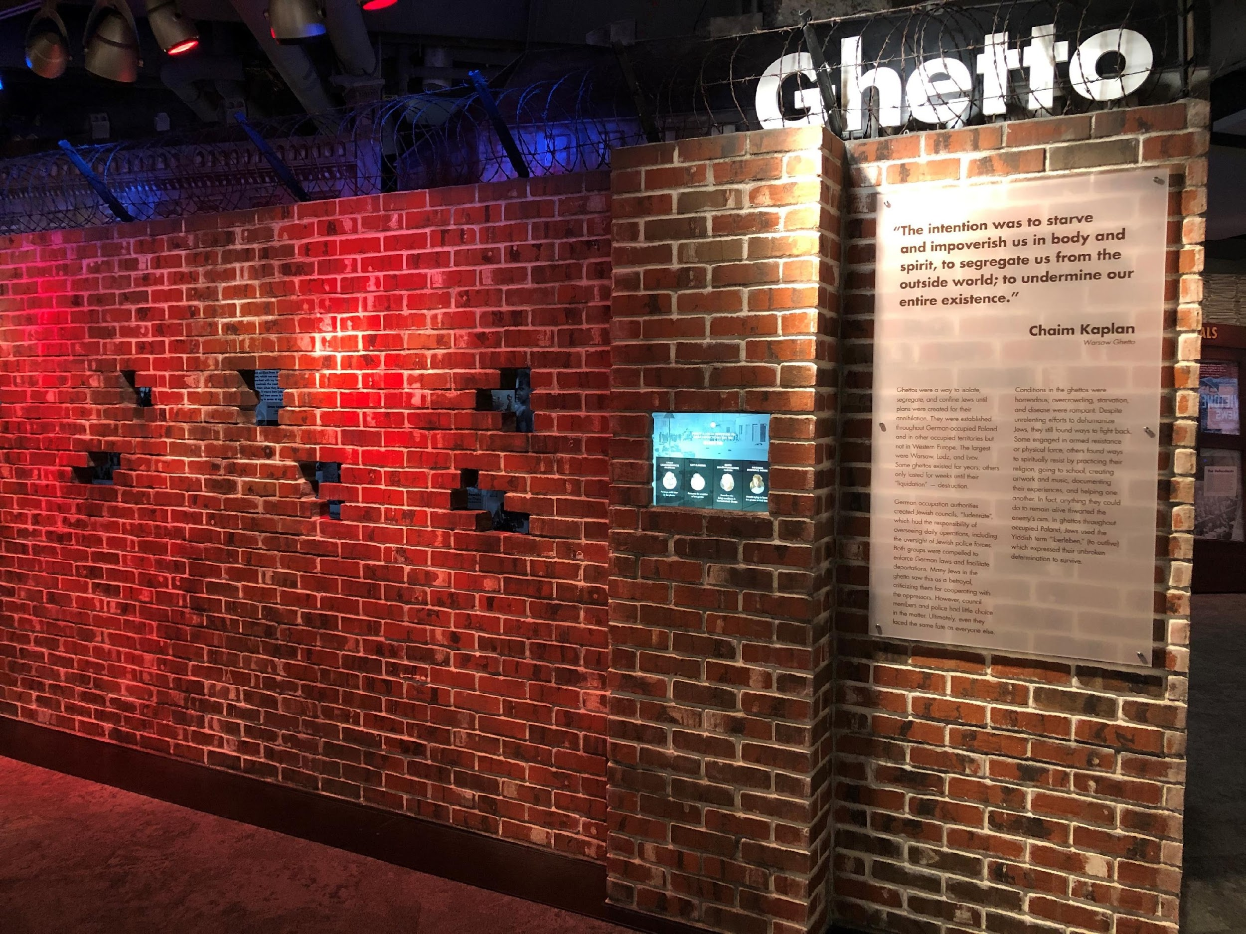
Ghettos
Listen to the audio clip.
Why were the ghettos created?
What were the conditions like?
Watch either Ray Kantor’s Testimony Clip or Roma Kaltman’s Testimony Clip.
What did you learn from their testimony?

Slide 12
Concentration Camps
Listen to the audio clip.
Who were the other prisoners in the concentration camps?
Who were the first people the Nazis rounded up?
What did you learn about the camps?

Slide 13
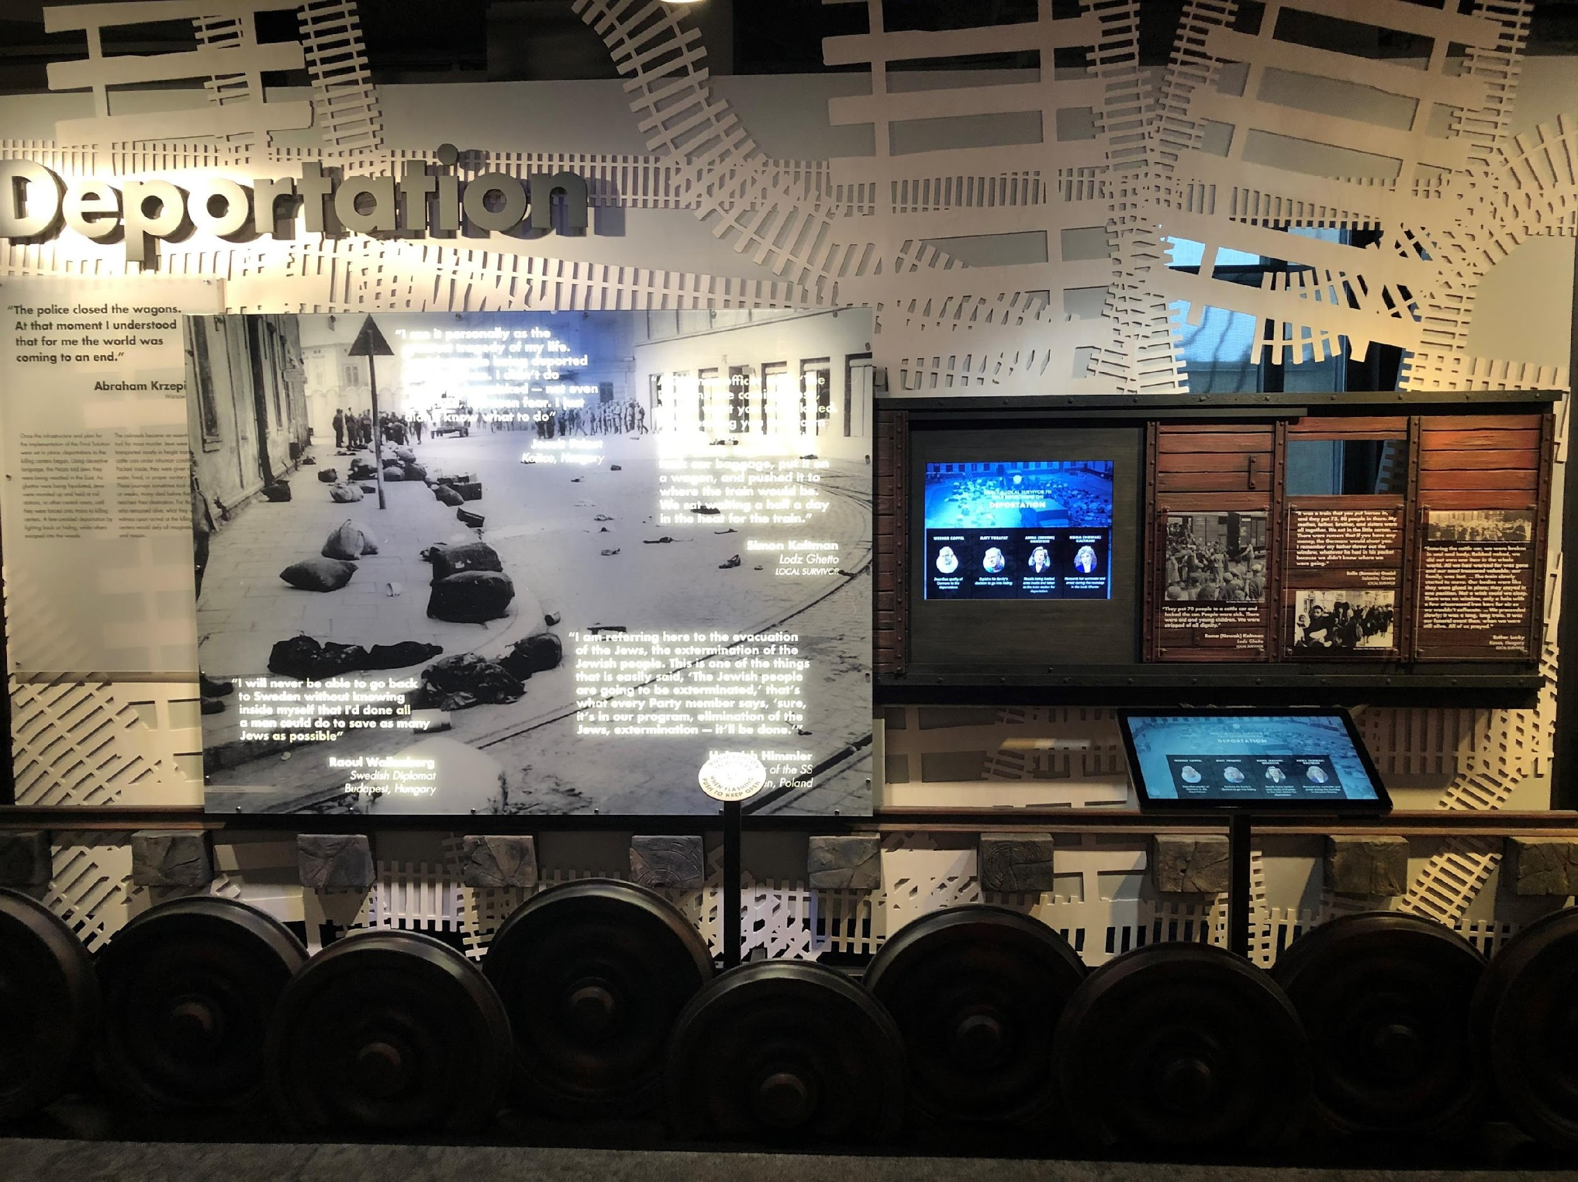
Deportation
What do you associate trains and the Holocaust with?
Listen to the audio clip. What did you learn about how HHC represents trains?
Watch Anna Ornstein’s Testimony Clip. What did you learn from her testimony?

Slide 14
Annihilation
Listen to the audio clip.
What do shoes represent?
What do you think the quote by Charlotte Delbo means?

Slide 15
Prisoner Uniform
Listen to the audio clip.
Why did Leo Wilich keep his prison uniform?
What can we learn from artifacts, like Leo’s uniform?

Slide 16
Liberation
Watch Milt Schloss’ Testimony Clip. What does Milt Schloss say about his experience?
Listen to the audio clip.
How did we learn about the camps? How does what you learned make you think about how we get our information today?

Slide 17
Aftermath
Read the quote from Eva (Gryka) Kohan.“I remember liberation. When they called out, ‘You are free, you are free.’ How can you understand the meaning of that? Everybody’s gone, you don’t have your family … but to hear you are free after all you have been through.”
What do you think she means?
What does it mean to be free to you?

Slide 18
Rebuilding
Read the quote from the Jewish New American Society, Cincinnati Survivor Group: “We want a memorial which will tell our tradition, how we died, and why, and how to prevent future massacres, something that will arouse people, something with an expression, something that will make sure our dear ones have not died in vain.”
Why did the survivors want a memorial?
Why do you think it is important to study the Holocaust?

Slide 19
Inspiring Action Today
Watch the clip of Werner Coppel from the Points of Light Theater.
Why did Werner Coppel decide to speak out?
What strengths did he use?

Slide 20
Character Strengths
Take the via survey or click on the strengths chart.
If you took the survey what are your top three strengths?
If you used the chart, what do you think your top 3 strengths are?

Slide 21
Be an Upstander
How would you define an Upstander?
Who is an Upstander in your own life?
Discuss a time that you were an Upstander, or a time that you wish you had been one?

Slide 22
Giving Back
Watch the clip of Edith Carter.
What are some ways you can contribute to your community?

Slide 23
Questions
A study of the Holocaust presents us with more questions than answers. Write down any other questions and (or) thoughts about the tour, or any other questions you have about the Holocaust.

