Slide 1

Notes:
STUDENTS: Click “Present” in the top right corner to get started!
TEACHERS: See the slide notes on each page for some context and additional ideas for how to implement and use these with your students. Please note: In advance of distributing this to students, please make sure you have instructed all of them to create an Upstander Journal (a physical or electronic place to store their notes, reflections, and ideas). The Upstander Journal will be referenced multiple times throughout all of the activity sets.

Slide 2
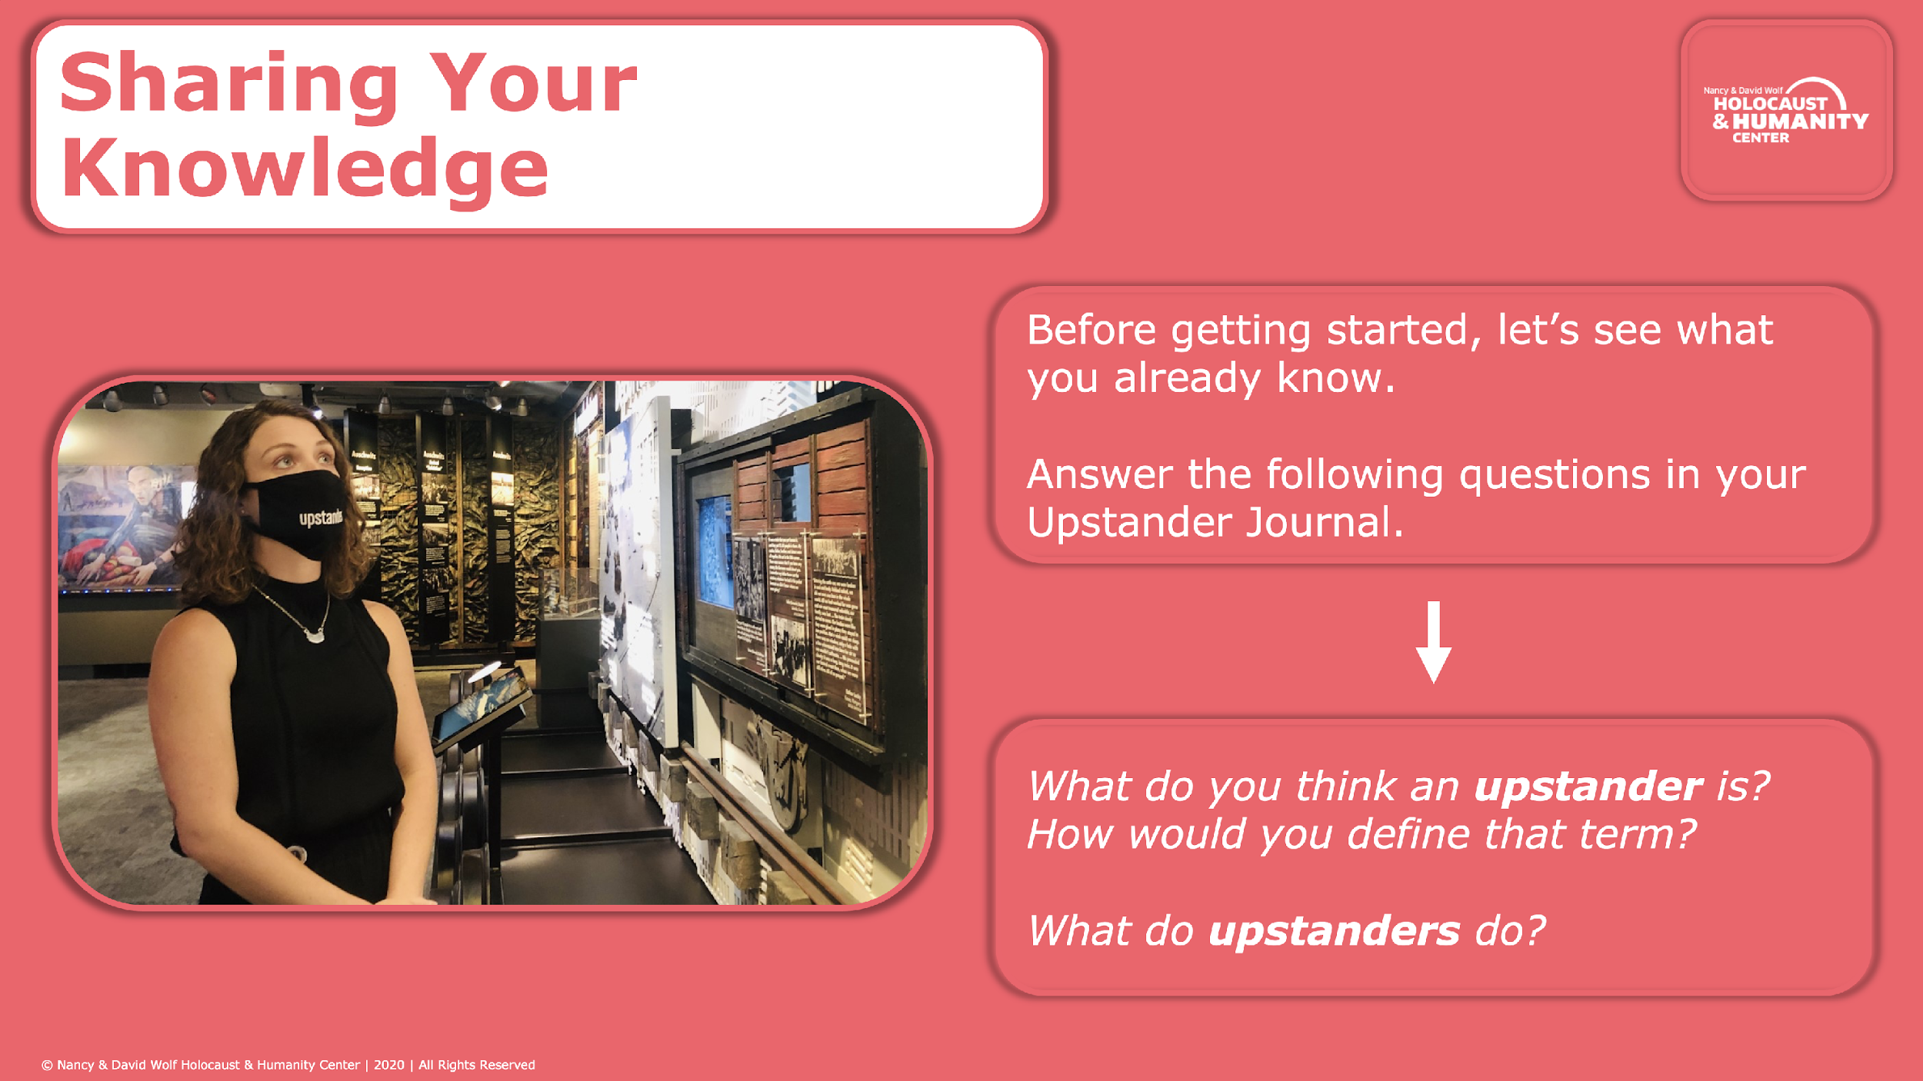
Notes:
TEACHERS: If students are having difficulty with this term, have them break it down. Instead of focusing on the word “upstander” – what does it mean to “stand up” for some something?

Slide 3
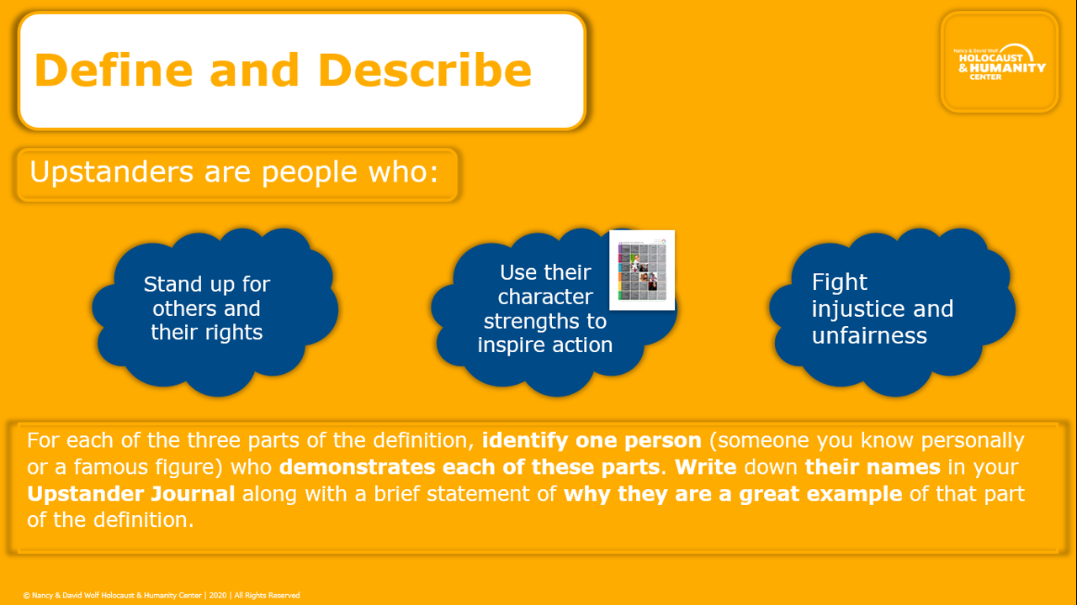
Notes:
TEACHERS: The character strengths chart is linked here in case students need to reference it. Be sure to establish Upstander Journal protocols and expectations before getting into this lesson. Given the demands of virtual learning, it could be good to have some sort of digital reporting process in place so students can share their ideas with you!

Slide 4
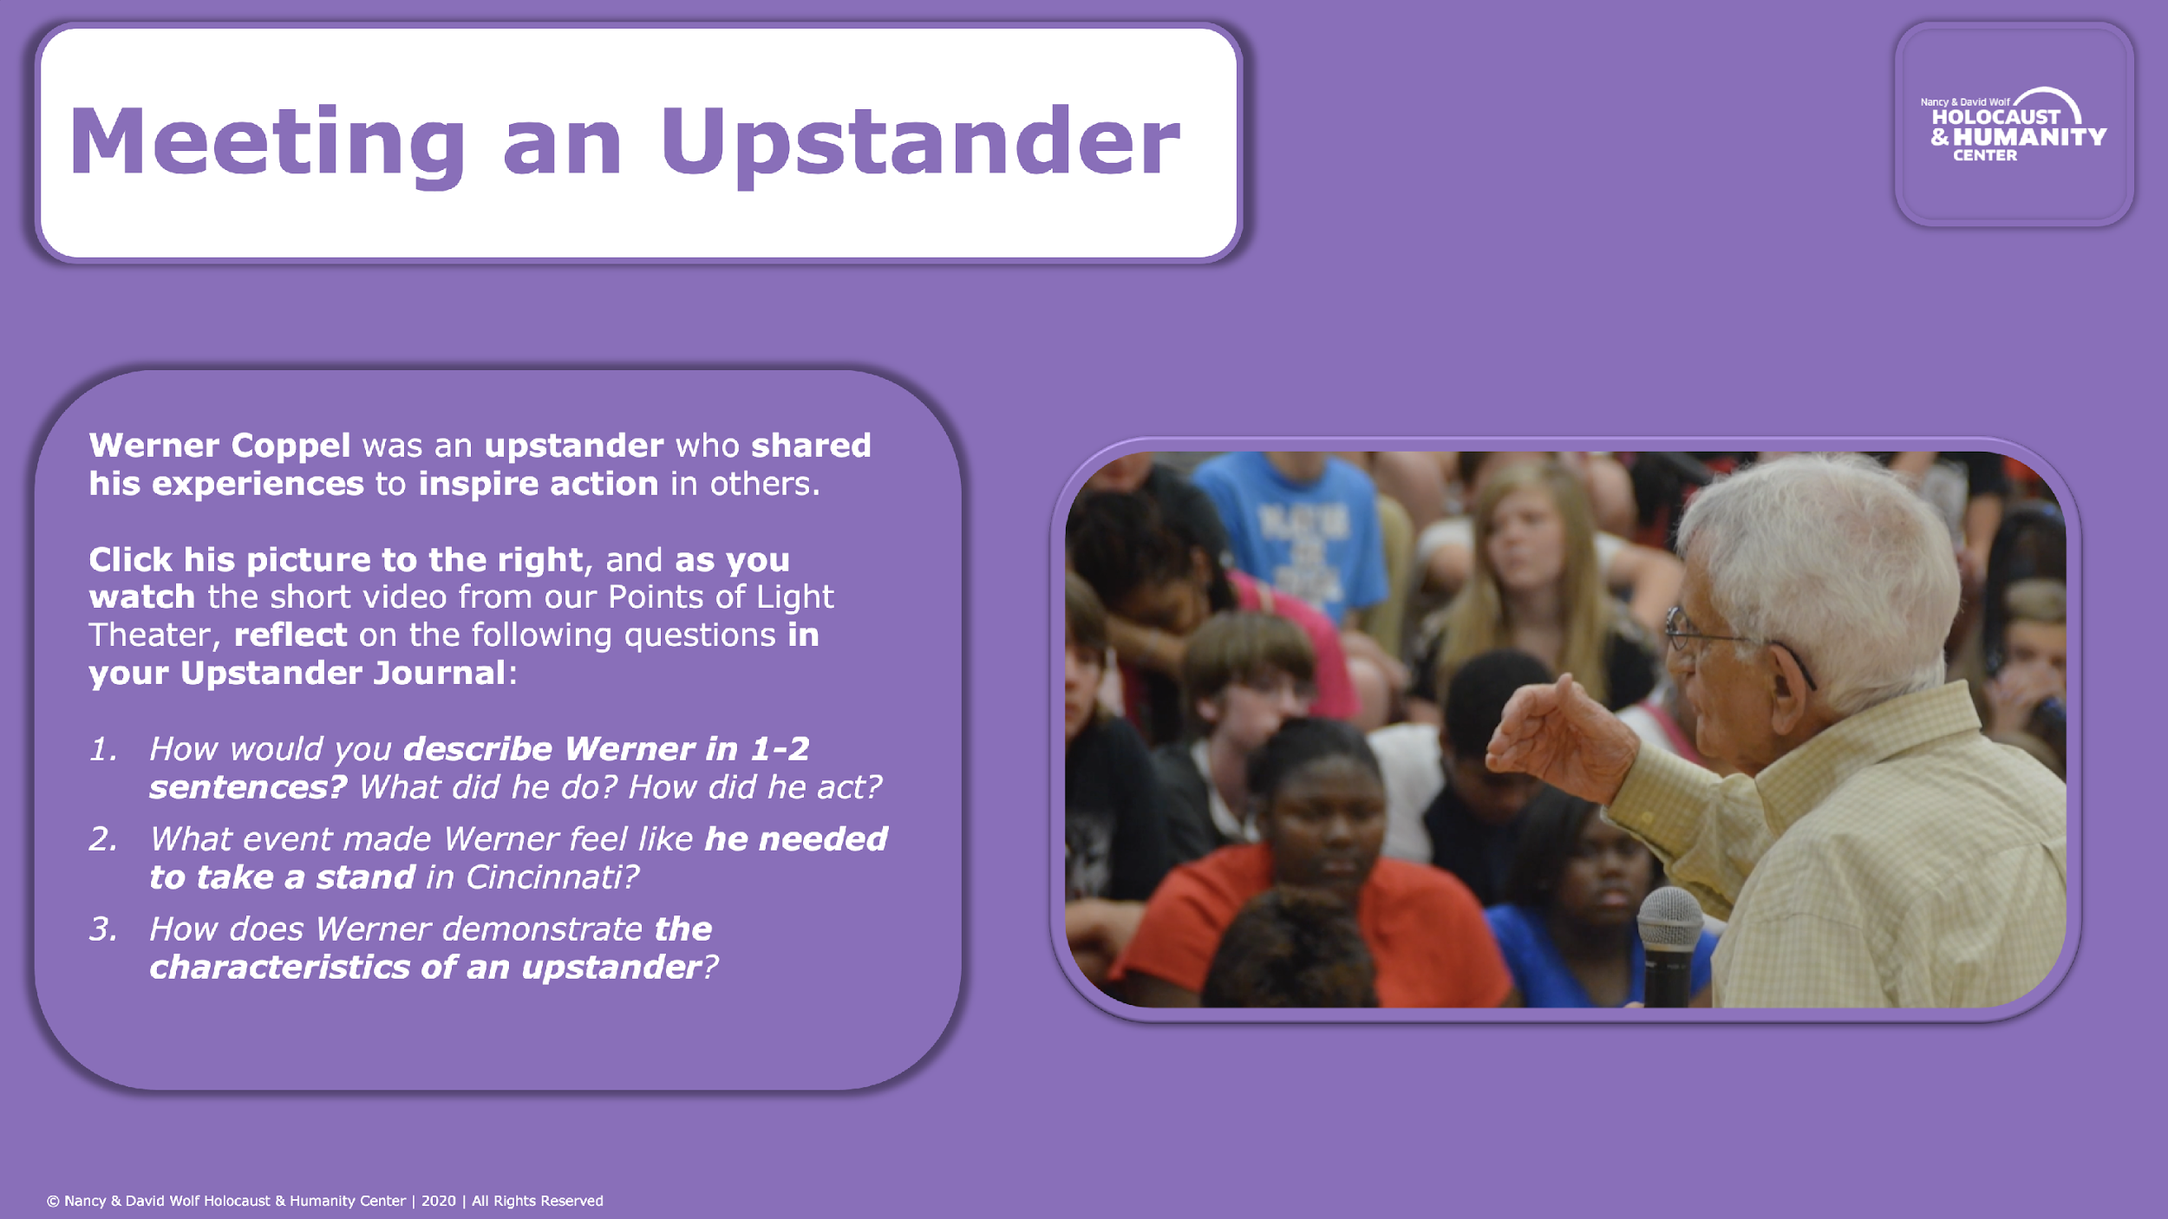
Notes:
TEACHERS: This is a great opportunity to make connections to your content area by using these same questions to highlight historical or present-day figures that you already highlight in your class. Consider using a slightly modified set of these same questions to build the concept that “upstanders” come in all shapes, sizes, and walks of life. You could use these same questions to learn about Alfred Nobel in Science, Dave Eggers in English, or Malala Yousafzai in Social Studies. Identify your own examples in your curriculum and use the actual language of ”upstander” to build the connection.

Slide 5
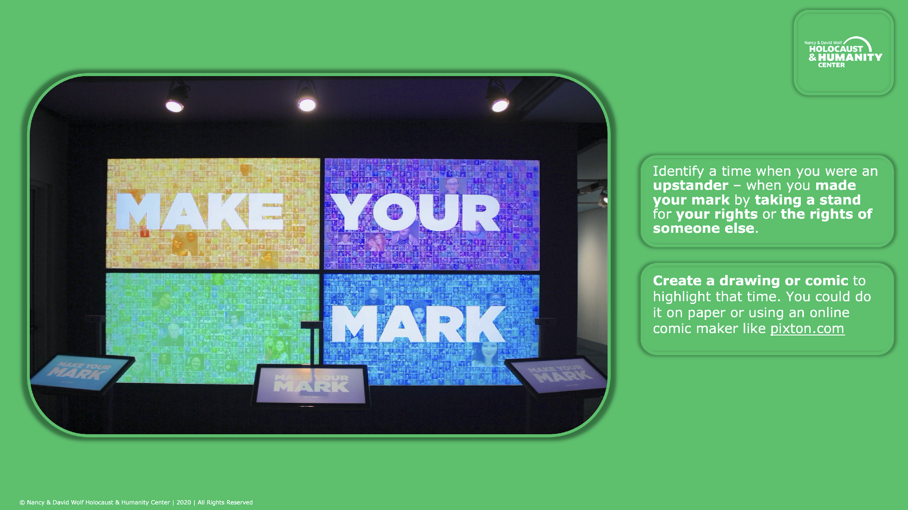
Notes:
TEACHERS: Decide in advance how you want students to share this with you. Here are three ideas:
1. If you use an online learning management system like Google Classroom you could create an assignment there,
2. You could have students email you their creations (as digital files or picture attachments), or
3. You could have them share during a live class session

