Slide 1
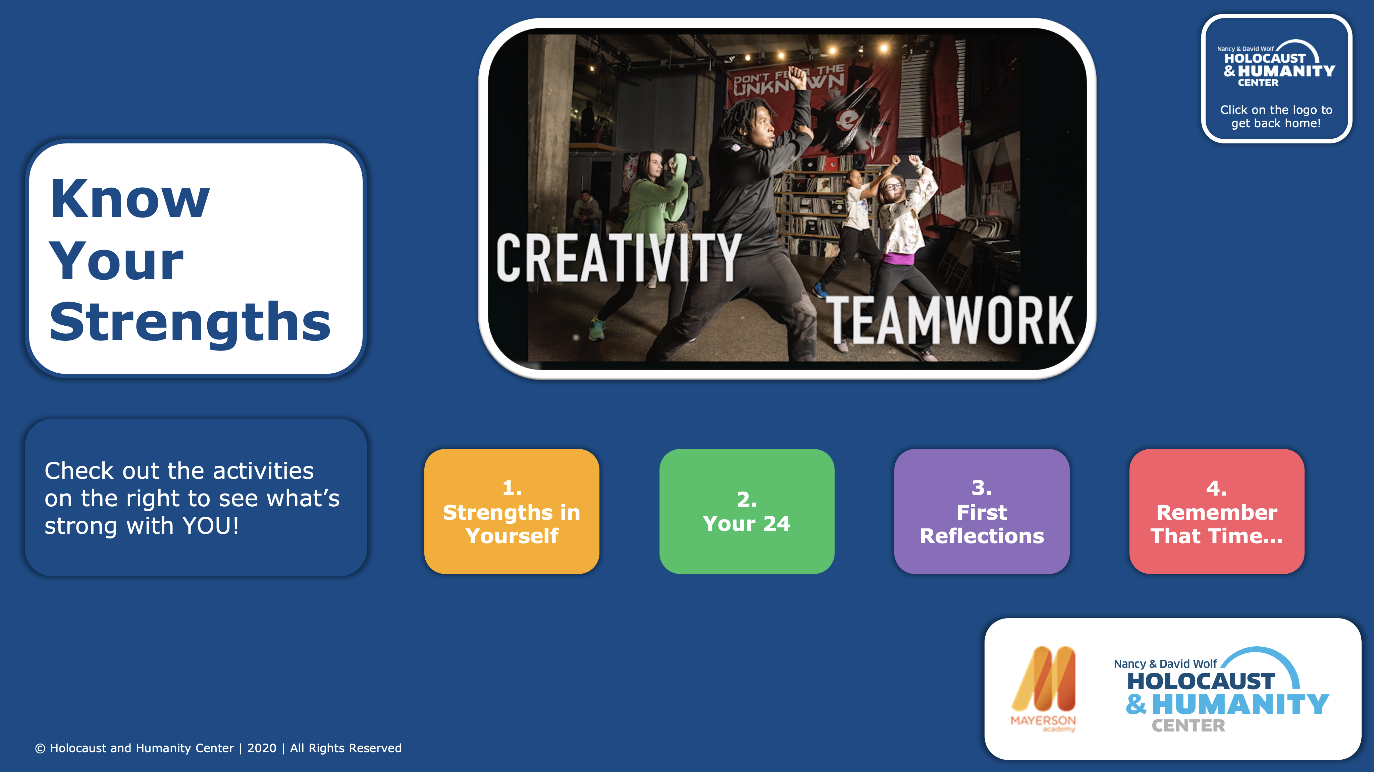
Notes:
STUDENTS: Click “Present” in the top right corner to get started!
TEACHERS: See the slide notes on each page for some context and additional ideas for how to implement and use these with your students. Please note: In advance of distributing this to students, please make sure you have instructed all of them to create an Upstander Journal (a physical or electronic place to store their notes, reflections, and ideas). The Upstander Journal will be referenced multiple times throughout all of the activity sets.

Slide 2
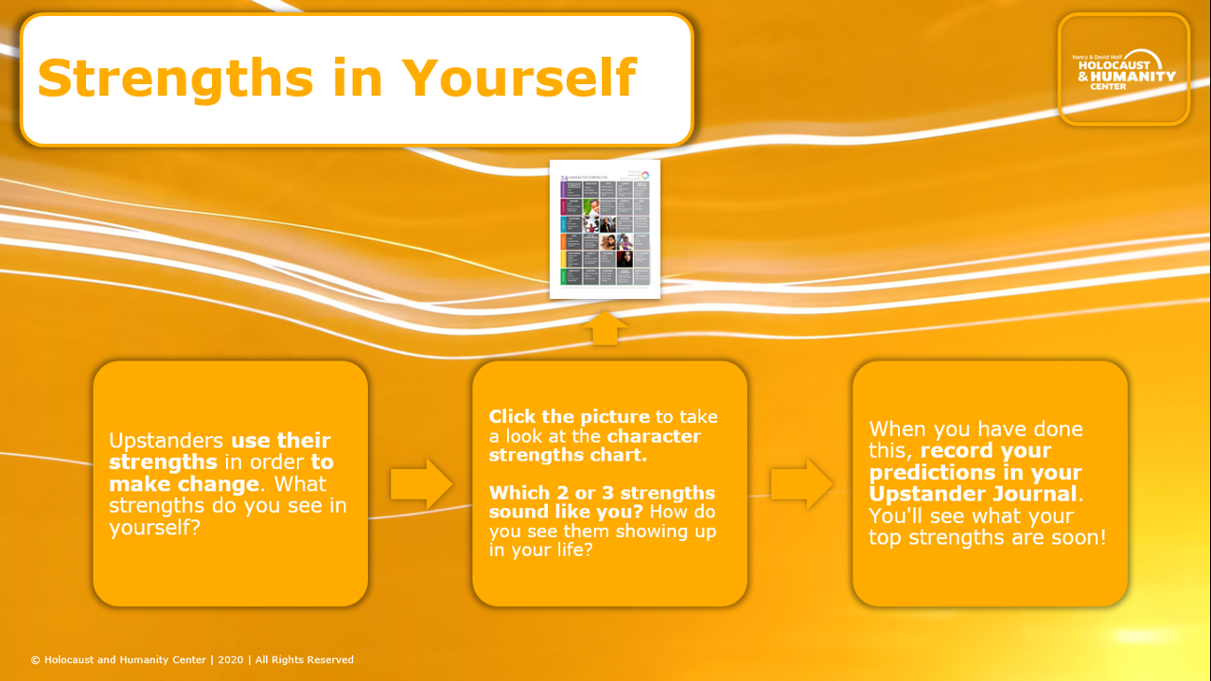
Notes:
TEACHERS: This can be a really informative and interesting way to get insight into your students' initial perceptions on strengths. We definitely recommend collecting their predictions in some way, either privately between you and your students, or having them share so their peers can also weigh in.
Additionally, if you are looking for more character strengths related resources, feel free to look here: https://drive.google.com/drive/u/1/folders/1lXpbo1KIyd1fCg6UF9lG-I8UKamJdNWb

Slide 3
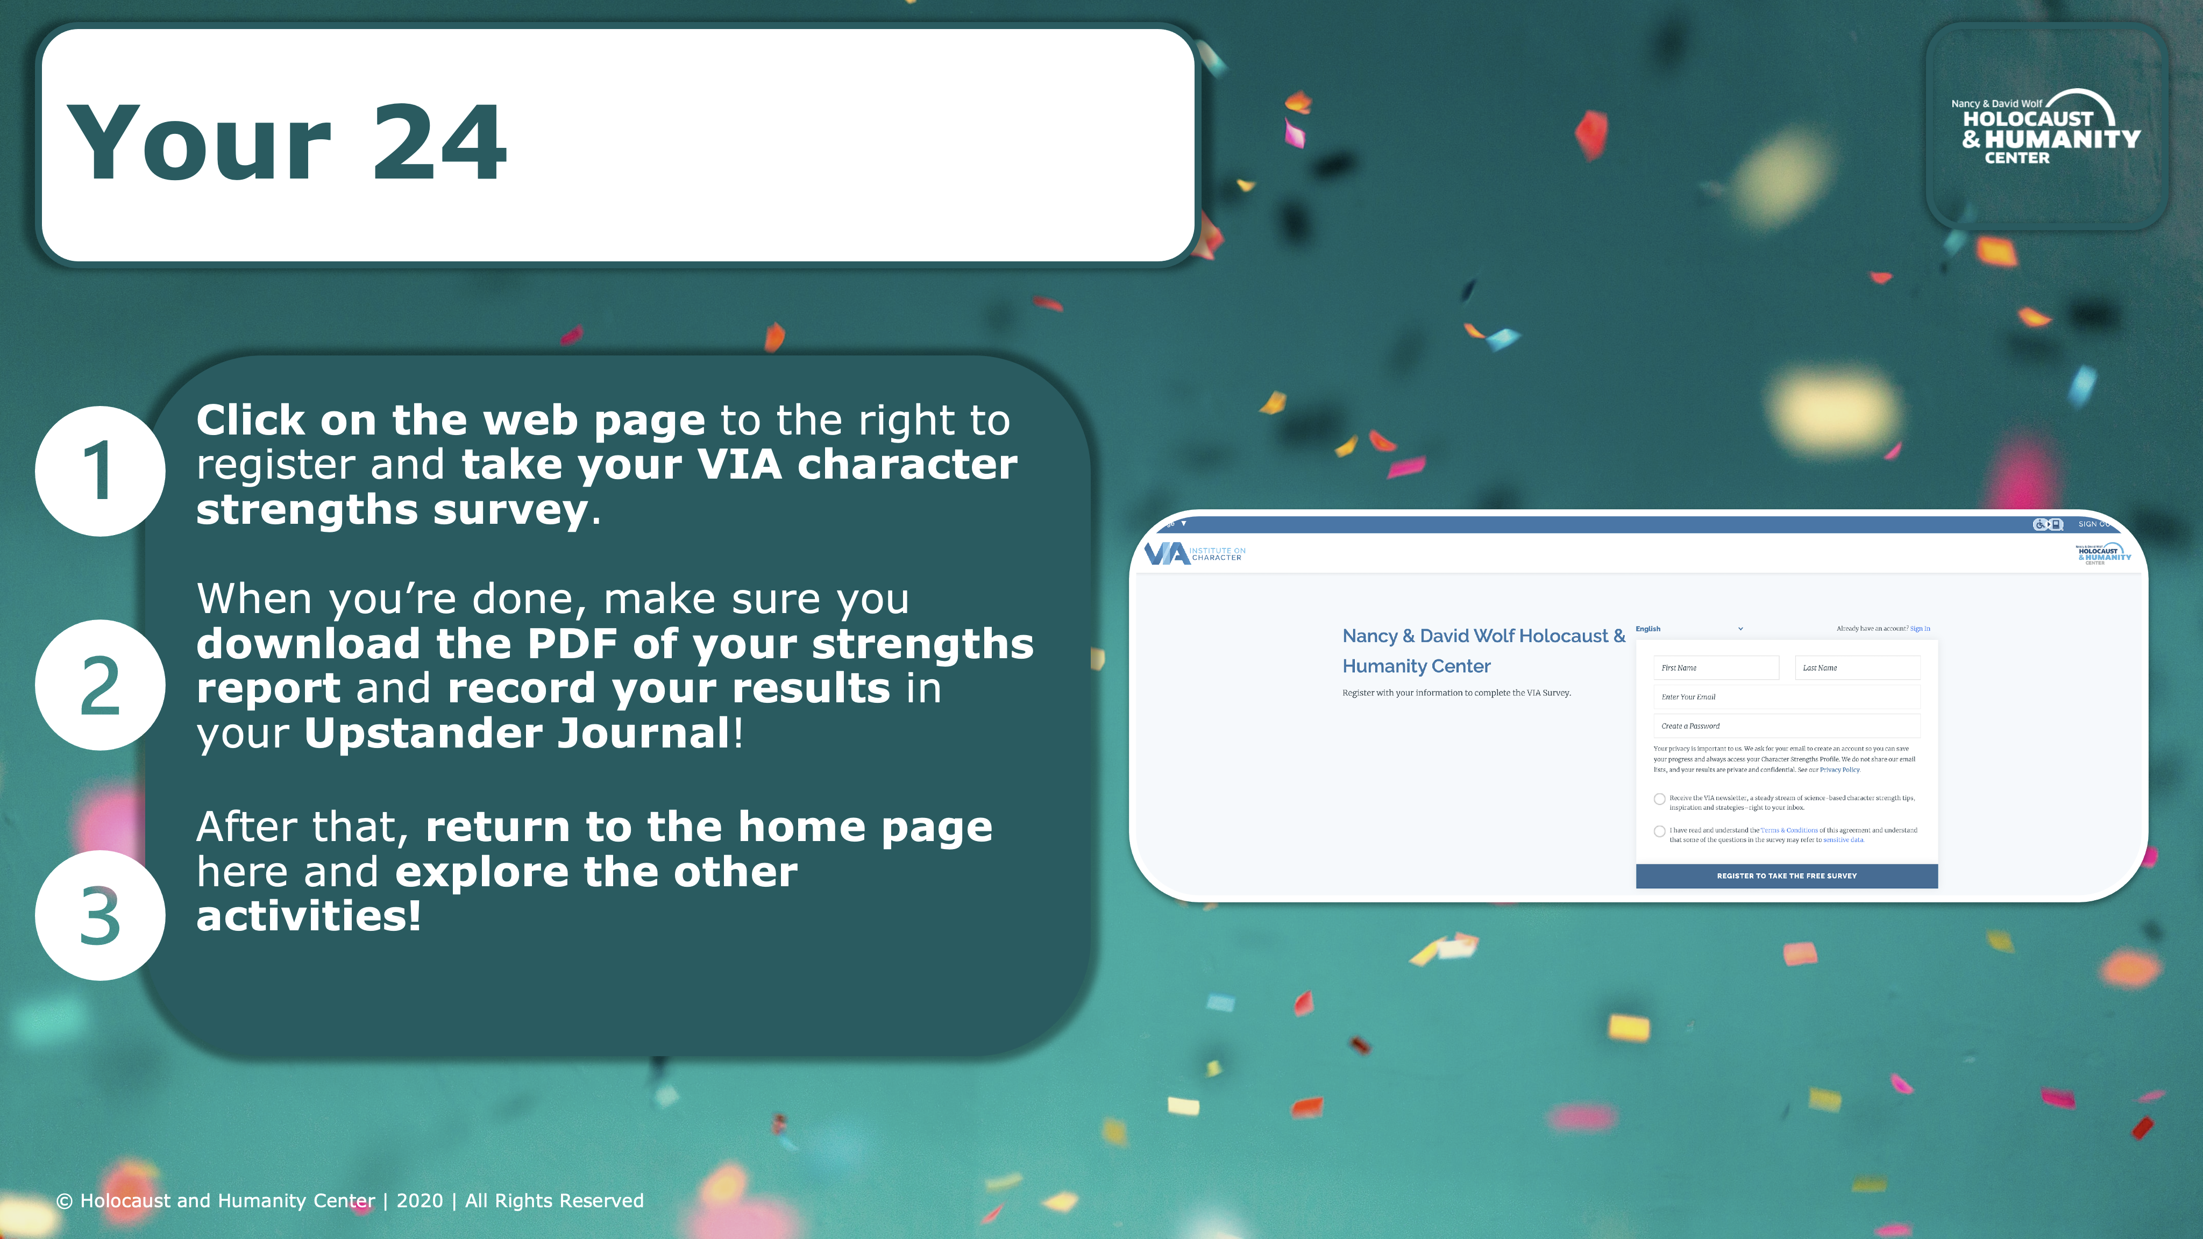
Notes:
TEACHERS: There are a number of logistical considerations for this activity:
It can be helpful to have students share their strengths reports with you so that you can reference them on an ongoing basis – and so that they don’t lose track of them! There is an option to download the PDF of the report at the bottom of the webpage where they see their results – consider having them email this to you to keep safe.
Showing the class’s strengths as a whole can be a fun result. This can be done with a simple spreadsheet, with a word cloud (try menti.com), or some other creative method to engage students in the strengths of their peers.
The survey takes approximately 20 minutes to complete. There are a lot of survey items but these are all needed in order to have an accurate picture of student strengths. Encourage your students to stay focused and on-task to complete this quickly!

Slide 4
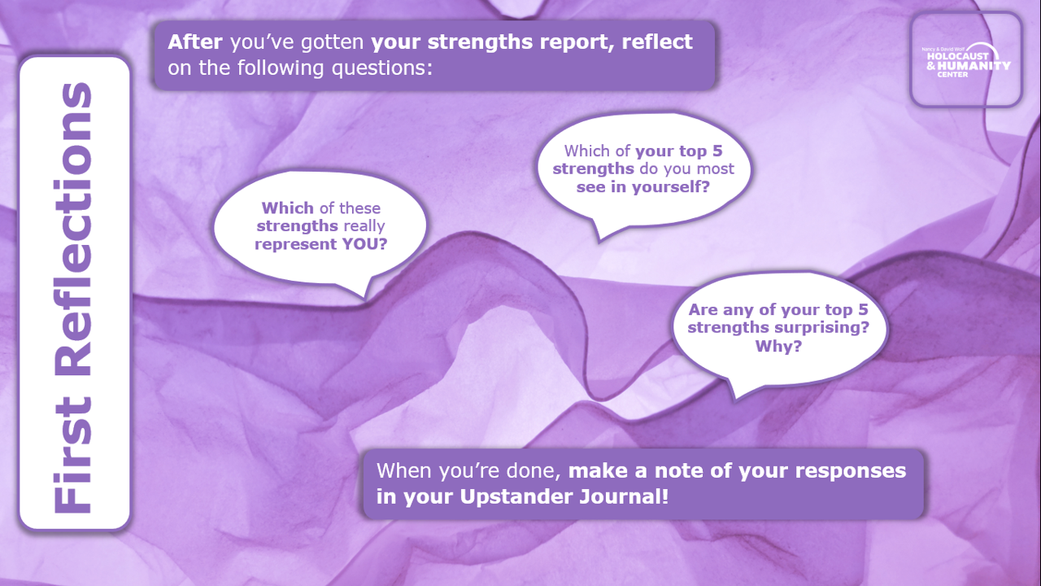
Notes:
TEACHERS: There is a prompt here for students to share with their partners. We recommend a pair and share option (either through breakout rooms or asynchronous methods like sharing over a Google Doc or Flipgrid). The asynchronous methods are great because they offer a chance for students to record their responses so you can review them all too!

Slide 5
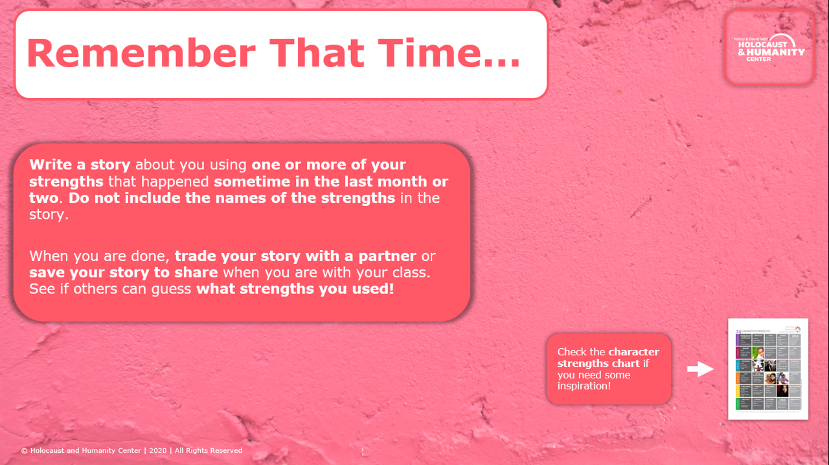
Notes:
TEACHERS: Similar to First Reflections, there is a prompt here for sharing. Since this prompt could use a little more deliberation, some kind of text-based exchange through your learning management system or an online discussion board could work well here.

