Slide 1
What is Antisemitism and Why Does it Matter Today?
An Introduction Lesson to Visiting the Nancy & David Wolf Holocaust & Humanity Center

Slide 2
Who are the Jewish people?

Slide 3
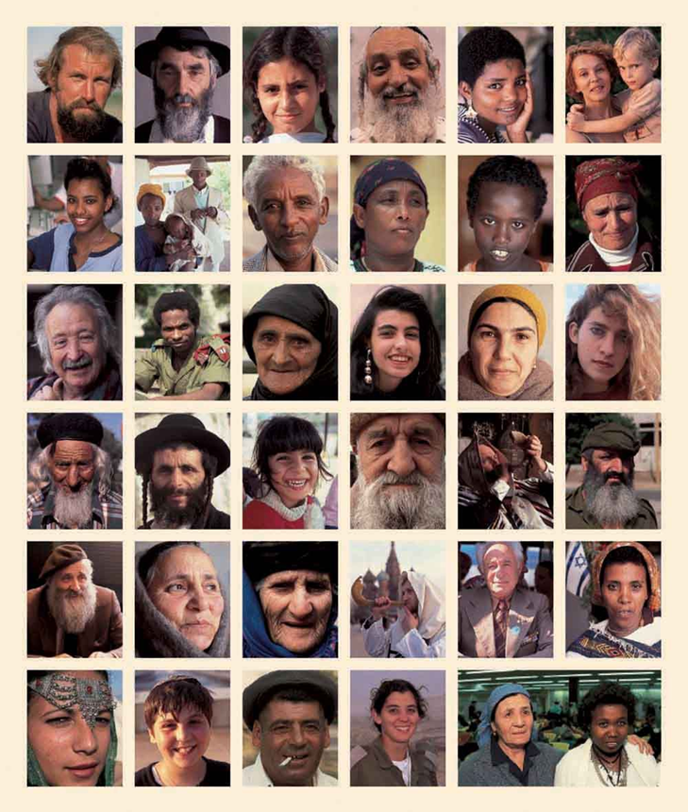
Who are Jewish people?
There are 14.7 million Jews in the world today, about 0.2% world population, and 2.% of the American population.
Jewish people are diverse.
Jewish identity is multifaceted.

Slide 4
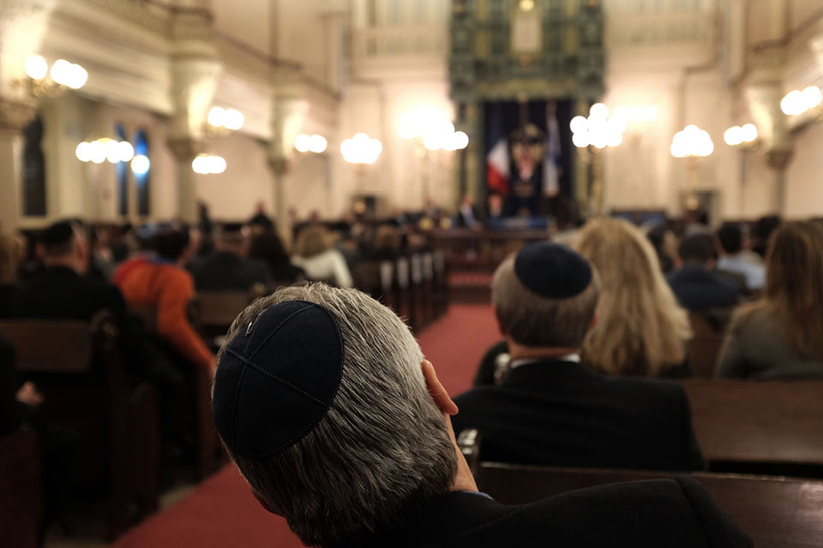
Who is a Jew?
Traditional/Rabbinic: A person born of the Jewish mother
Who is also: A believer and observant in Jewish religious tradition and rituals
Belief in one God as omnipotent, omniscient, omnipresent
God does not have human form

Slide 5
Antisemitism is prejudice or hatred towards Jews.

Slide 6
Why does Antisemitism Matter to Us?
“Antisemitism begins with the Jews but does not end with them.”
Deborah E. Lipstadt, United States Special envoy to monitor and combat antisemitism
Antisemitism is an alarm, signaling that not all is well in a democracy, as this type of hatred goes against the fundamental principles of liberal societies. Although it targets Jews it also is a catalyst to other forms of racism, hatred and prejudice.

Slide 7
As you watch the video on the next slide, answer the following questions:
1. What is Judaism?
2. How did antisemitism begin?
3. What is ONE core tenet of antisemitism? (multiple will be mentioned)
4. What does antisemitism look like? Give ONE example.
5. Why does antisemitism matter to all of us?

Slide 8
What is antisemitism?
Watch until 7:06.

Slide 9
Before we begin the activity, reflect on what you learned in the video.
What is antisemitism?

Slide 10
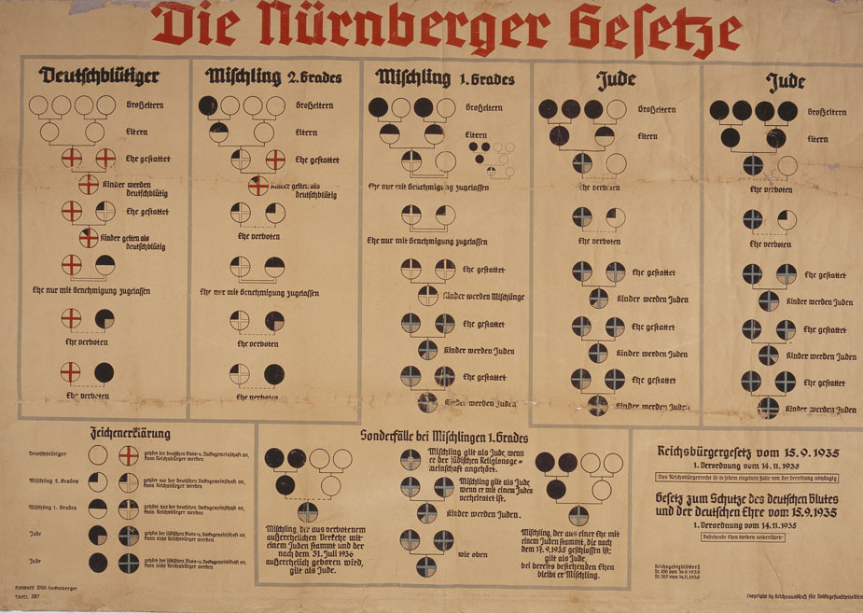
Jim Crow, Segregation & The Nuremberg Laws
Racism, including racial antisemitism, was the core element of Nazi ideology.
Racism also legitimized the continued oppression and persecution of African Americans after the end of slavery.
The Nazis were interested in finding legal precedent to create the laws and looked to Jim Crow Segregation legislation in the U.S.

Slide 11
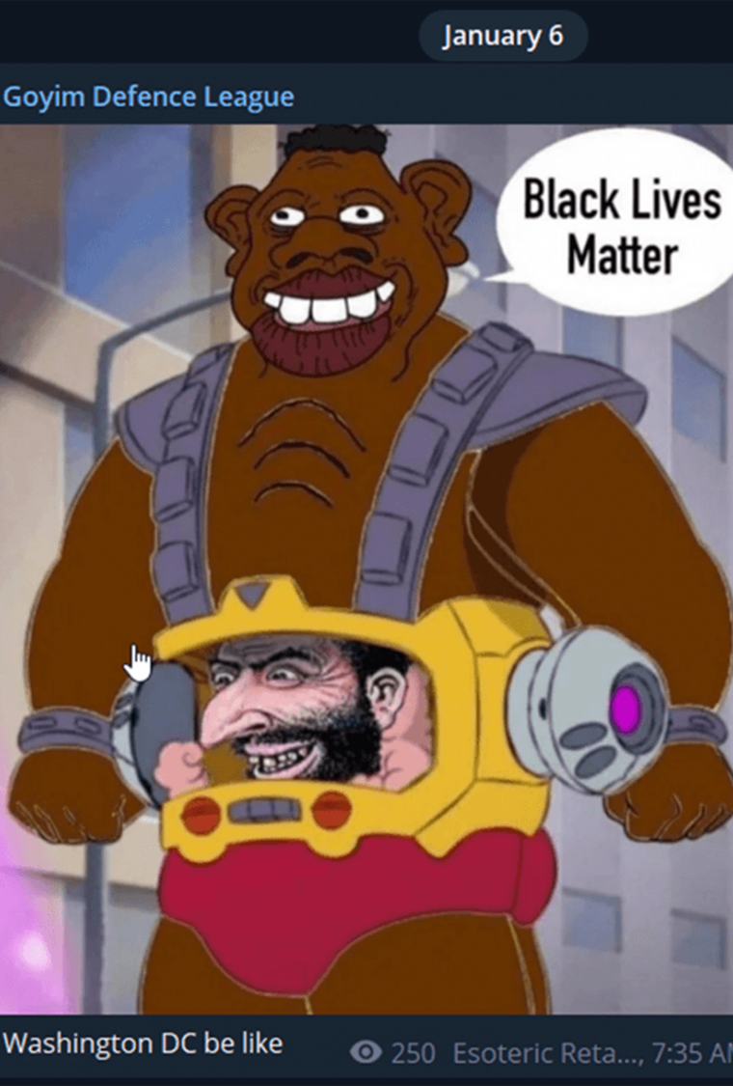
Intersections of Hate
"Scratch below the surface of most mission-oriented hate crimes against Sikhs, Muslims, Jews, Blacks, and Latinos, and you will find the equal-opportunity poison, the ideology of antisemitism.”
“What I mean is that antisemitism isn’t just making the lives of Jews harder; it’s killing the rest of us too.”
- Eric Ward
Watch this video featuring Eric Ward

Slide 12
Antisemitism Station Activity

Slide 13
Antisemitism Station Activity
You will examine examples of antisemitism in the following areas:
Laws
Propaganda
Holocaust survivor testimony
At each virtual station, you will write the answer to the question at the top of the slide, using the evidence from the laws, propaganda, and testimony.

Slide 14
STATION 1 LAWS: Identify 3 ways Jews were targeted BEFORE Nazi Rule.
Roman Empire 70 C.E.: The Romans destroyed the Jewish Temple and 60 years later expelled the Jews from (Roman named) Palestine.
The Crusades January to July 1096: 12,000 Jews, between 1/3 and ¼ of the Jewish population in Germany and France, were massacred by the crusaders.
The Black Death 1348:(or bubonic plague) spread across Europe and killed one third of the population. As a result, Jews were accused of spreading the disease and thousands of innocent Jews were murdered in response.
70 C.E.
6th century
Jan.–July 1096
1215
1348
1394
Justinian Era 6th century: Roman Emperor Justinian issued a series of anti-Jewish rulings that; Excluded Jews from all public places, Jews could not hold public office.
Middle Ages 1215: The Fourth Lateran Council issued a decree whereby Jews were ordered to wear special clothes and markings to distinguish themselves from Christians.
Expulsion: Jews were expelled from England in 1290, France in 1182, 1306 and again in 1394, and parts of Germany in the fourteenth and fifteenth centuries. Spain in 1492.

Slide 15
STATION 1 LAWS: Identify 3 ways Jews were targeted DURING Nazi Rule. Then, explain the similarities & differences between laws before and during Nazism.
Germany, April 7, 1933
The Law for the Restoration of the Professional Civil Service removed Jews from government service.
Germany, September 15, 1935
The Nuremberg Race Laws defined what it meant to be Jewish and excluded German Jews from Reich citizenship. It also prohibited Jews from marrying or having sexual relations with persons of “German or German-related blood.”
Germany, October 15, 1936:
The Reich Ministry of Education banned Jewish teachers from public schools
Germany, August 17, 1938
The “Law on the Alteration of Family and Personal Names” required Jews who did not have “Jewish first names” to take the middle names “Israel” (for men) or “Sara” (for women).
Germany, November 1938
The Decree on the Exclusion of Jews from German Economic Life closes all Jewish-owned businesses; The Reich Ministry of Education expels all Jewish children from public schools.
Germany, September 1, 1941
Jews over 6 forced to wear a Yellow Star of David with 'Jew' written on it

Slide 16
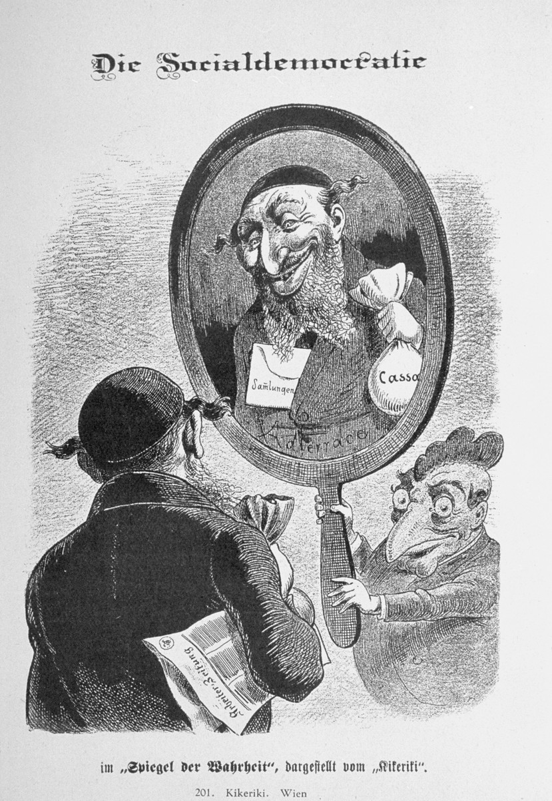
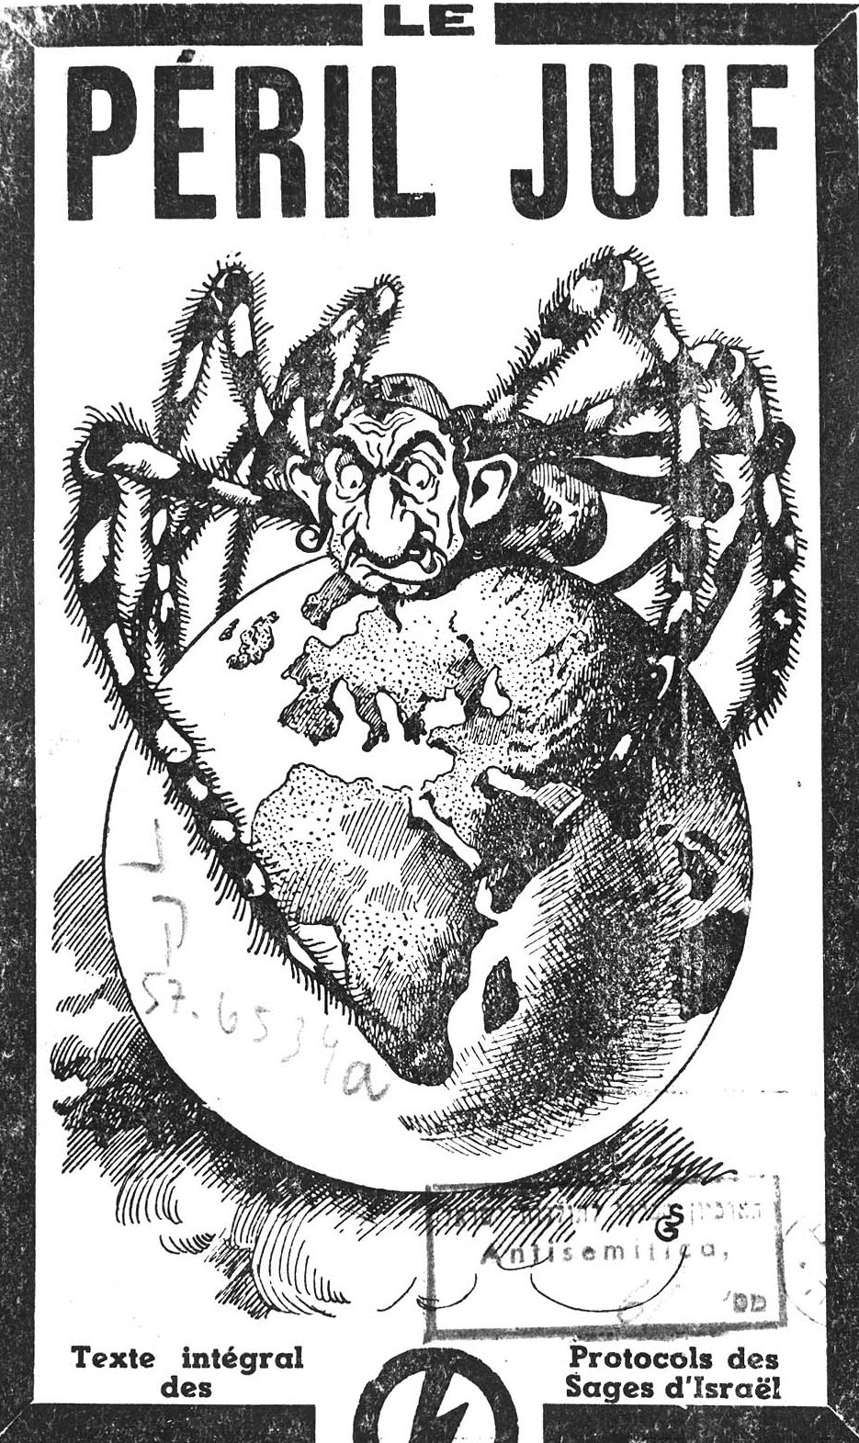
STATION 2 PROPAGANDA: Examples of PRE-NAZI government propaganda. What is the message of the images? What creative techniques were used? How might Jewish people versus non Jewish people perceive the messages?
Burning of the Jews, published in the Nuremberg Chronicle, 1493 (woodcut) Example of religious antisemitism.
1920, Vienna, Austria. Caricature from the antisemitic Viennese magazine Kikeriki. Example of economic antisemitism.
1921, French version of the Protocols of the Elders of Zion. Example of political antisemitism.

Slide 17
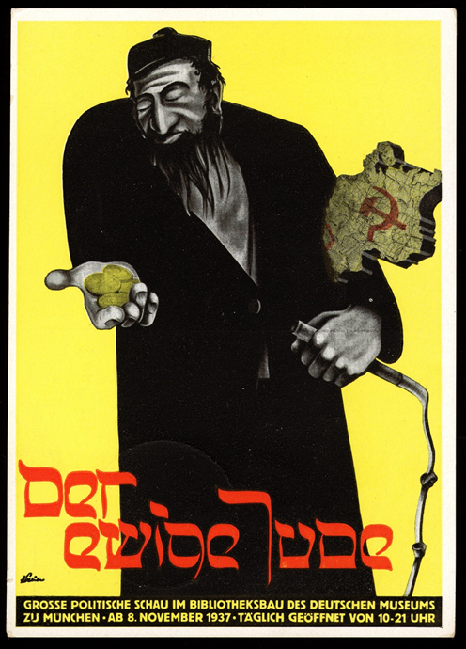
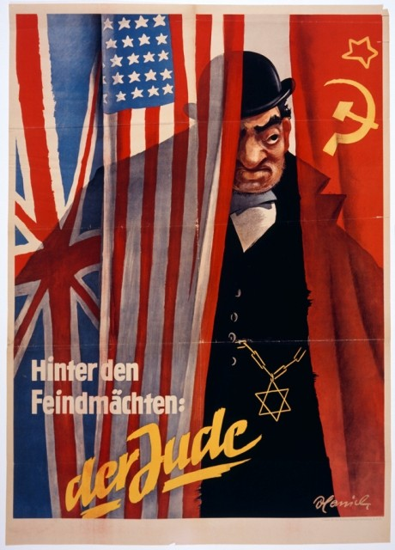
STATION 2 PROPAGANDA: Examples of NAZI GOVERNMENT propaganda. What is the message of the images? What creative techniques were used? Then, explain the similarities & differences in propaganda before Nazi rule and during Nazi rule.
1935
1937
1942

Slide 18
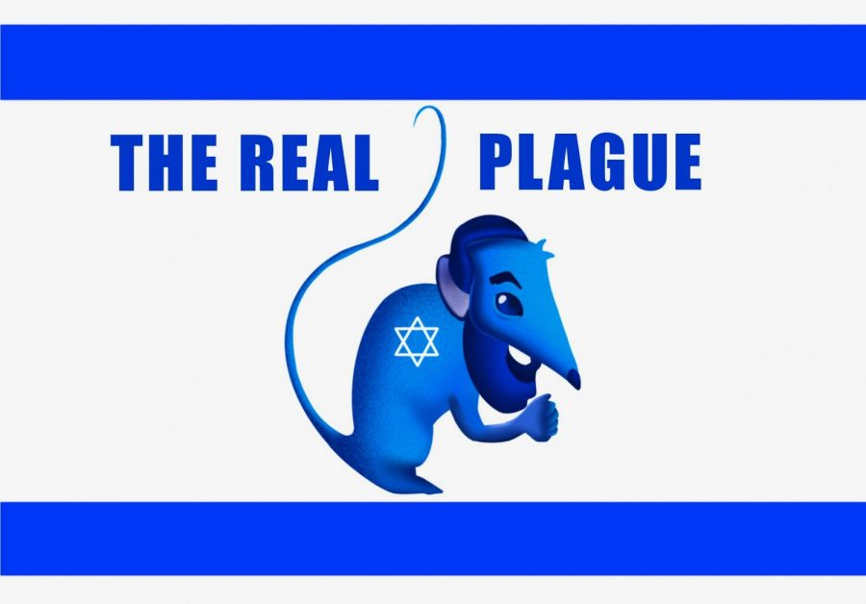
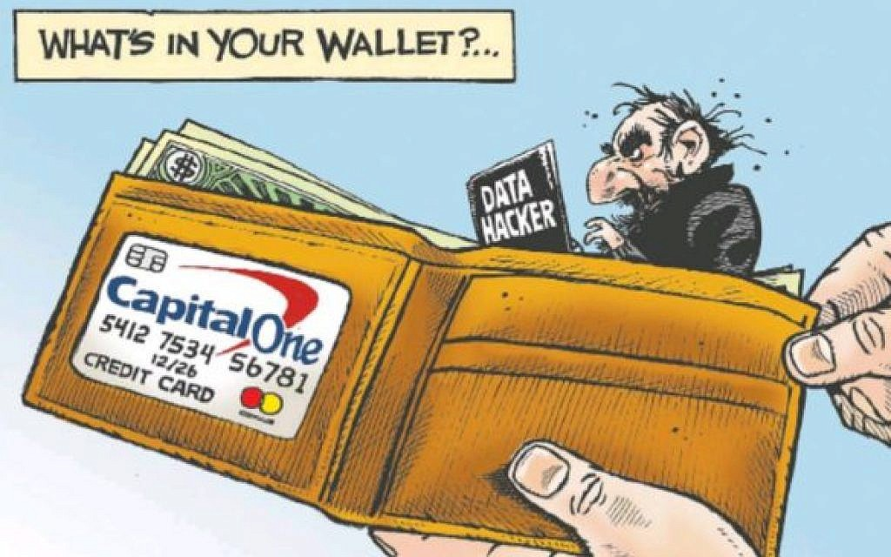
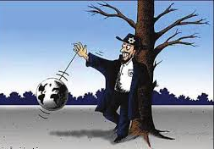
STATION 2 PROPAGANDA: Examples of CURRENT-DAY 21ST CENTURY antisemitic propaganda What is the message of the images? What creative techniques were used? How do these images compare to the historic examples on the other slides?

Slide 19
Station 3: Survivor Testimony
What are examples of antisemitism that happened in the lives of Holocaust survivors before World War II began?
Watch these videos of local survivors about life before the Holocaust began:
Al Miller - talking about Nuremberg laws (1935)
Paul Heiman - explains his experiences during Kristallnacht
Edith Carter - talks about her experiences from 1923 through 1939, when the Germans invaded Czechoslovakia (watch from 0:00-2:12)

Slide 20
Antisemitism Today

Slide 21
As you look at the information on the following slides, record the following information:
Key Ideas: What ideas are important to remember? What new terms or concepts have been introduced?
Response: What questions does this information raise for you? Why do you think this information is important and/or relevant? What do you think of these ideas?

Slide 22
ADL H.E.A.T. Map
Anti-Defamation League has created a map to track instances of:
Hate
Extremism
Antisemitism
Terrorism
Click here to go to a live, interactive version of the map.

Slide 23
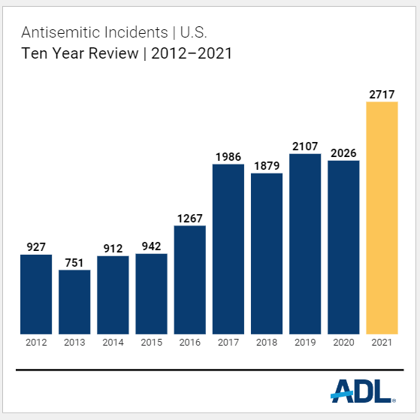
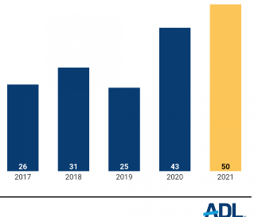
Antisemitism in Ohio
Here is a sampling of antisemitic incidents in Ohio recorded by ADL in 2021:
February: During a remote class at a public school, a student changed their name to “burn all the Jews.”
June: The president of a Northeast Ohio school board received a vulgar, antisemitic message on his telephone. The caller said that Jews should harmed and killed, and that “Hitler should have finished the job.” The same individual sent a threatening email to all members of the same board of education.
July: A white male in a car slowly drove by a Jewish family walking to synagogue. The driver made an offensive hand gesture, screamed profanities, and verbally harassed the family. (University Heights)
November: Youngstown JCC received an online threat: “I will be at your center today and tomorrow planting bombs then I’ll shoot all you Jewish parasites !! there is bombs planted now to blow you filthy scum jews up”. (Youngstown)

Slide 24
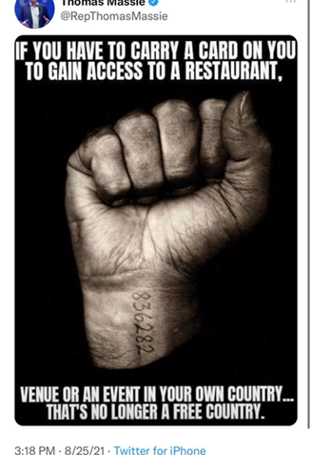
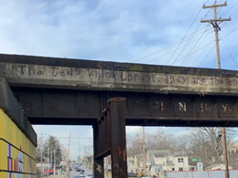
Images of antisemitism in Ohio 2020-2022
Notes:
This picture was taken in April 2020 at the Ohio Statehouse. People were protesting the stay-at-home order. The sign reads, “The Real Plague,” with a rat that has a Star of David on it. Throughout history, Jews have been identified as animals that need to be eradicated. This sign is making it clear that the real problem is not the COVID-19 crisis, but the Jews in society. At the time, the Ohio Director of Health was a Jewish woman.
This tweet is from Thomas Massie, a member of the House of Representatives from Northern Kentucky, in August 2021. Tattoos were put on prisoners at the Auschwitz concentration camp during the Holocaust. Here is article about the tweet.
This graffiti was painted on a railroad bridge crossing Madison Road in Cincinnati in March 2020. It read, “The Jews killed Christ. They are the enemies of the whole human race.” Article about the graffiti.

Slide 25
EXIT TICKET
What is antisemitism and why does it matter today?

