Slide 1
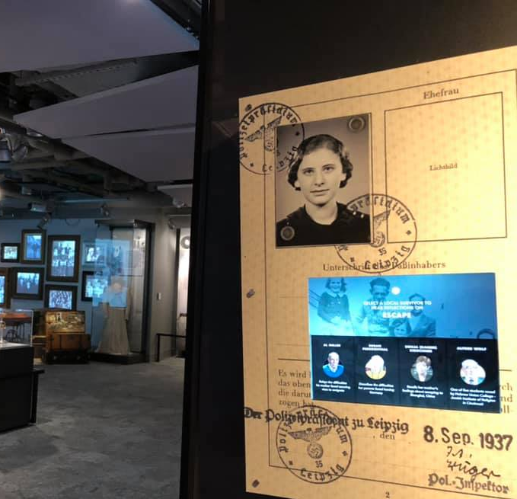
Why didn’t the Jews just leave?
The story of the Tuttmann Family: A Primary Source Inquiry Activity

Slide 2
Building Context: Historical Timeline
Read Over
Read over the timeline in front of you. As you do, annotate with the following:
Bracket
Put a (bracket) around to the event that restricted immigration into the United States (Think: How long before WWII did this occur? What will be the consequences for Jewish refugees in the 1930s)?
Underline
Underline the event that changes everything for Austrian Jews.
Circle
Circle the date WWII begins.
Check Mark
Put a check mark next to TWO events that show conditions worsening for Jews in the 1930s

Slide 3
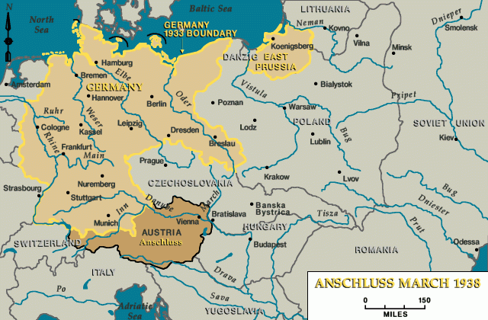
Map: USHMM

Slide 4
1930s Emigration & Immigration Policy
Examine the documents that were needed to get into the United States and out of Nazi Germany. Underline three barriers Jewish refugees faced when trying to escape Austria, specifically.

Slide 5
Austrian Emigration Diagram 1941
Emigration Diagram, The Archives of the Jewish Community of Vienna
Notes:
In 1938 the Nazi government established Central Office for Jewish Emigration in Vienna run by Adolf Eichmann. Jews had to fill out an emigration questionnaire before they could leave and had to go through several official channels, pay taxes, obtain confirmations and stamps, and pay taxes and fees. Visas were only valid for a limited time, and if they expired the entire administrative process had to start over. This diagram depicts the various steps in the Austrian emigration process.

Slide 6
Dr. Josef Warkany
Josef Warkany, M.D., was born into a middle-class Jewish family in Vienna, Austria in 1902. He completed medical school there in 1925 with dual interests in pediatric clinical practice and medical research.
Due to limited opportunities in post WWI Europe, Dr. Warkany emigrated to the United States in 1932. Following the Anschluss in 1938, Dr. Warkany received dozens of desperate requests from family members, friends, colleagues, and even strangers.
He was successful in securing affidavits and guaranteeing financial support for his mother and sister to join him in the U.S.

Slide 7
Why didn’t the Jews just leave?
To answer today’s central historical question, we are going to look at three letters from the Tuttmann family to Dr. Warkany as well as a letter Dr. Warkany sent to British Prime Minister Neville Chamberlain.
British Prime Minister Neville Chamberlain holding up the Munich Agreement September 30, 1938.
Chamberlain believed it would bring “Peace in our Time.”

Slide 8
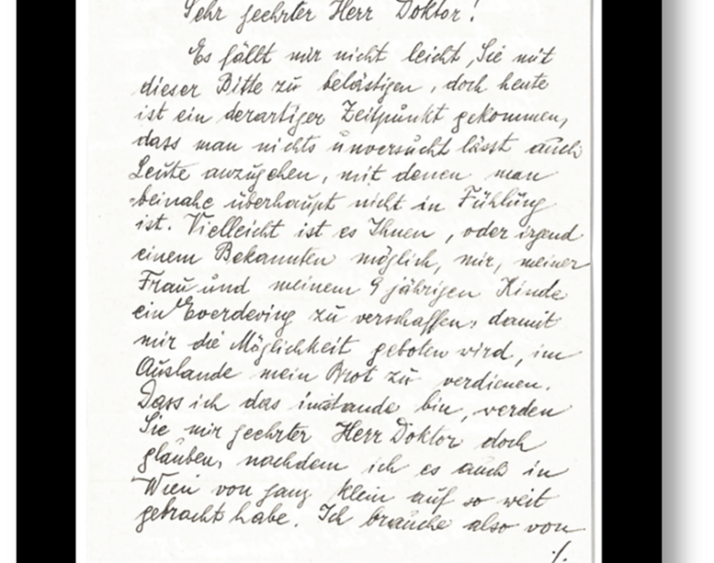
Document Inquiry
As you read each document, answer the corresponding guiding questions. We will debrief as a class after each document. Finally, we will discuss the summary question.

Slide 9
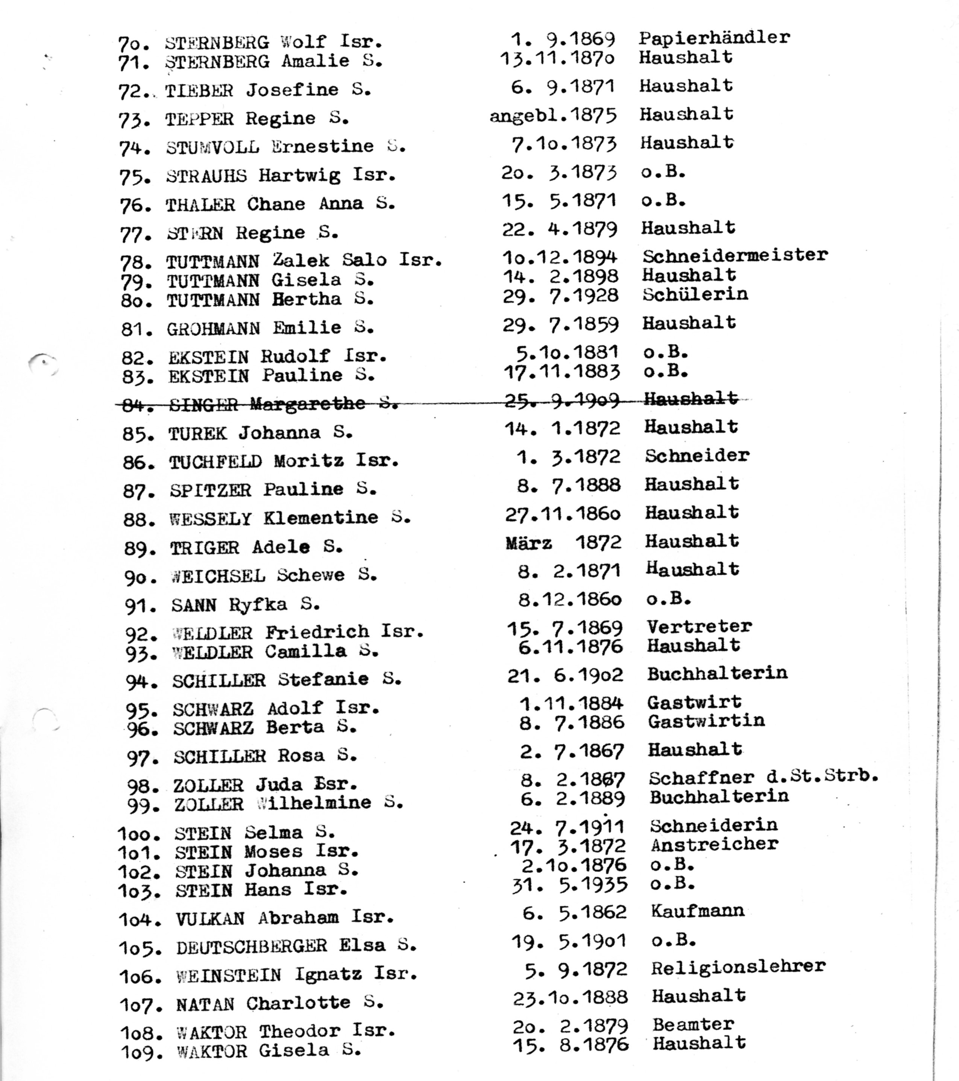
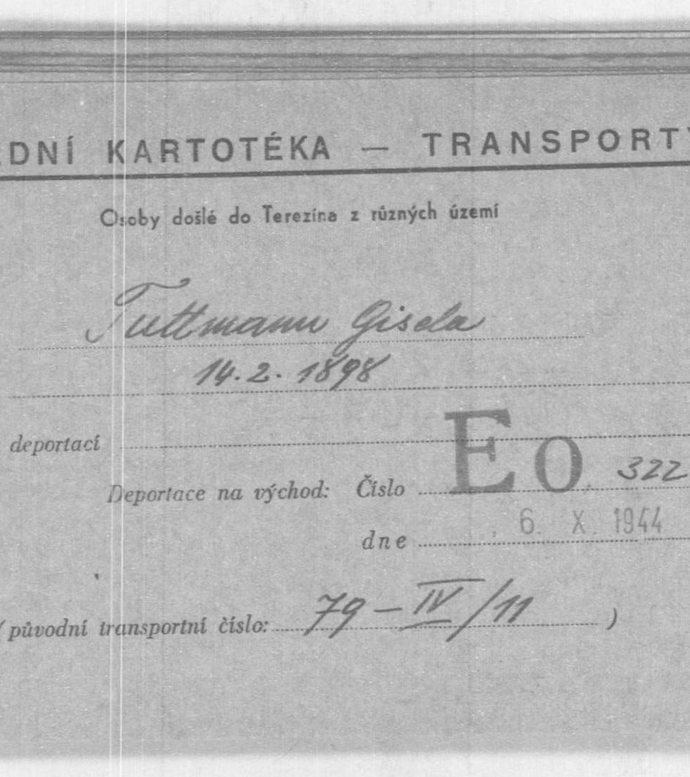
What happened to the Tuttmann family?

Slide 10
Deportation from Vienna
On September 24, 1942, the Tuttmann’s were among 1,300 Jewish deportees from Vienna who were sent to Theresienstadt (Terezin) outside of Prague.
Transport 42 was the eleventh transport from Vienna to Terezin.
At the time of the deportation, Salo (Zelek), was 48, Gisela was 44 & their daughter Hertha was 14.

Slide 11
Theresienstadt (Terezin)
Theresienstadt served as a transit camp for Czech Jews being deported to the East, and a ghetto-labor camp for German, Austrian, and Czech Jews, who were WWI veterans, famous artists, musicians and other cultural figures, as well as elderly individuals.
Conditions were horrible, and disease, starvation and death were daily occurrences. There was also a cultural life that became a way for Jews to escape from their reality for a short while.
It was used for propaganda purposes to hide the nature of the deportations of the German Jews.
Theresienstadt. Center for Holocaust & Genocide Studies University of Minnesota

Slide 12
Deportation to Auschwitz
After two years in Theresienstadt, Salo Tuttmann was deported on September 28,1944 transport EK to Auschwitz. The transport arrived the next day on the 29th.
There were 2499 people on the transport, who were taken directly to Auschwitz-Birkenau. Only 472 survived the war. Based on the dates and his age, it is believed that Salo was sent to his death in the gas chamber.
Gisela & Hertha were deported to Auschwitz on October 6, 1944, on Transport EO arriving at Auschwitz-Birkenau on October 9. There were 1,550 men, women and children on the transport, only 72 survived. It is believed that Gisela & Hertha were sent to their death in the gas chamber.
Map: USHMM

Slide 13
Auschwitz
Auschwitz was a large complex that contained three camps: Auschwitz I, the main camp, housed mainly Polish political prisoners, and Auschwitz III (Buna-Monowitz) provided slave labor to German industrial firms. Auschwitz II (Birkenau) was the killing center.
At Birkenau, arriving prisoners were forced off the trains, men and women were divided, the young and able-bodied were “selekted” for work, the old and very young were sent to one of four gas chambers.

Slide 14
How do we Know what Happened?
Researchers were able to use the information in the Tuttmann letters to search various databases for more information. Deportation documents at the Arolsen Archives and a page of testimony at Yad Vashem (filed by a childhood friend of Hertha’s who survived the war) were corroborated, giving researchers an understanding of the Tuttmann family’s fate.

