Slide 1
RESCUE IN THE PHILIPPINES
AN UPSTANDER STORY

Slide 2
Introduction to the Resource
Rescue in the Philippines: An Upstander Story is an asynchronous or synchronous activity that emphasizes the importance of using one’s character strengths to be an Upstander.
There are questions for the students to reflect upon and answer, and links to learn more about the history of World War II and the Holocaust as it relates to the Frieder brothers, Paul McNutt & Manuel Quezon who worked together to bring Jewish refugees to the Philippines.
Also included are tour clips recorded in the Museum. The clips feature an HHC staff member telling the history and story of the upstanders and refugees, as well as local survivors.
To go further with the resource, you can view the education version of the Rescue in the Philippines film either before or after using the activity. There is also a website devoted to the making of the film with interviews, photographs and primary source documents.
For more on how to be an upstander we have four additional activity boards you can use with your students.

Slide 3
Defining Upstander
Define what an Upstander means to you?
Watch the Tour Clip . How does the Holocaust & Humanity Center define Upstander?
Did it match your definition? How was it the same? How was it different?

Slide 4
Character Strengths
Every individual possesses all 24-character strengths in different degrees, giving each person a unique character profile. When you know your strengths, you can improve your life and thrive.
Take the Via Character Survey to find out your 24 or click here for a chart of the strengths.
After watching the last clip- what character strengths did the refugees needed to have?
What are your top Five strengths?

Slide 5
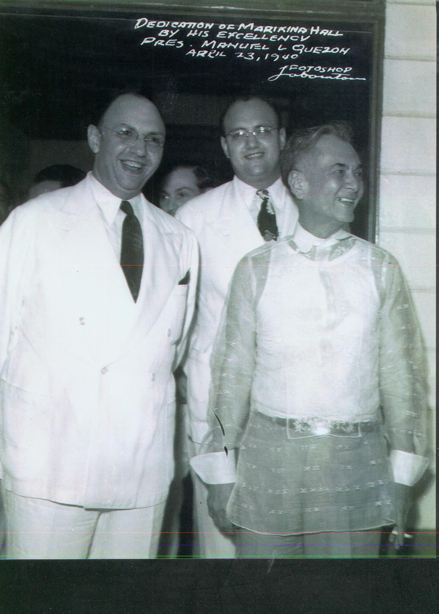
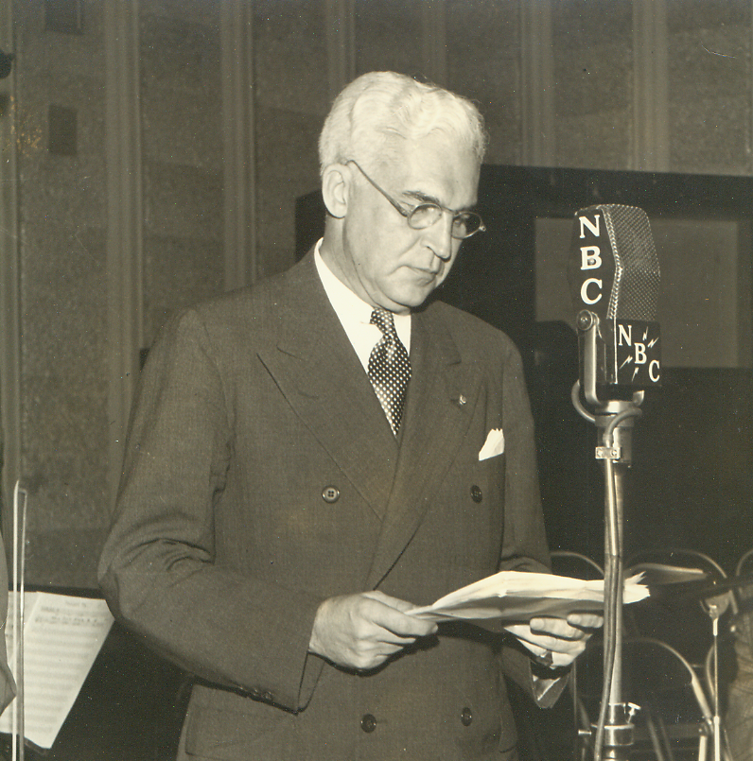
The Upstanders
“This very special group of upstanders, a group of men who seemingly had nothing in common, but who came together to save approximately 1,300 Jews during World War II.”
In this activity you will learn about the Frieder brothers, cigar makers from Cincinnati, Paul McNutt, former Governor of Indiana, and acting High Commissioner of the Philippines, and Manuel Quezon, President of the Philippines came together to rescue Jews during World War II.
Paul McNutt, former Governor of Indiana and acting High Commissioner of the Philippines
Alex & Herbert Frieder with Manuel Quezon, President of the Philippines.
Morris, Herbert, Philip, Henry & , Alex Frieder, Cincinnati/Manila, Cigar Makers.

Slide 6
Introduction
Watch the Introduction to the Tour. What character strengths did the upstanders use to help the refugees?
Read the quote. “They didn't think they did anything remarkable. They really didn't. I mean we don't know that much about it because they never talked about it.” (Jane Frieder Ellis, Daughter of Morris Frieder ) Why do you think the Frieder's did not talk about what they did to help the refugees?

Slide 7
Mosaic Jewish Life
Watch the Tour Clip . What are three things you learned about Jewish life before World War II?
What did you learn about Jews in Manila?
Learn More: Jewish Life before World War II

Slide 8
The Philippines is an archipelago country in Southeast Asia in the western Pacific Ocean. At the end of the Spanish-American War in 1898, the Philippines became a U.S. territory under the administration of the United States. In 1935, the first national presidential election took place, making Manuel Quezon the first President of the Philippine Commonwealth.
Learn More: The Philippines

Slide 9
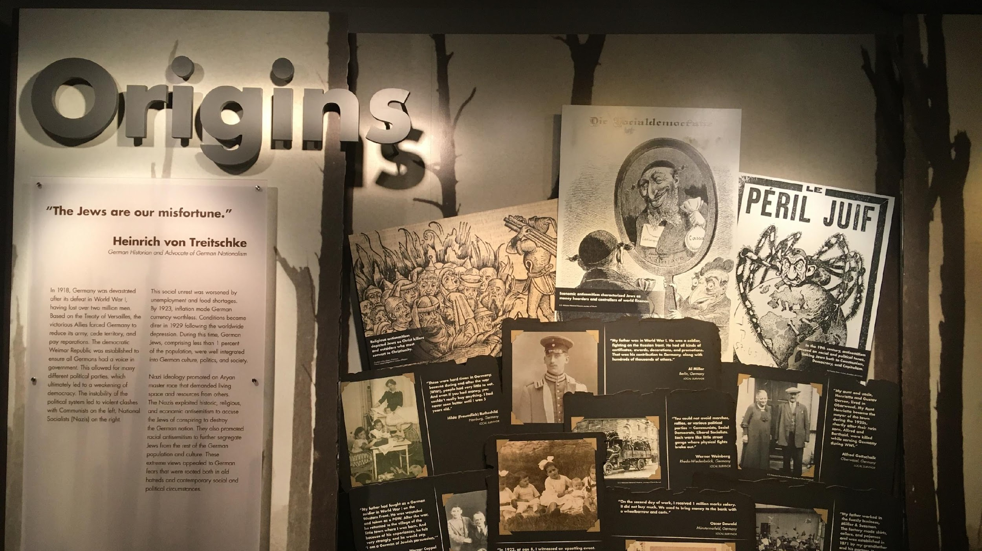
Origins
Watch the Tour Clip. What did you learn about Al Miller’s & Lotte Cassel’s fathers? What does this tell you about how they saw themselves?
What was the population of Germany in 1933? Did this surprise you, if yes why, if no why?
Learn More: Jewish Life in Prewar Germany

Slide 10
Power
Watch the Tour Clip and read the quote. “No Government can long endure that fails to guarantee to its people the right to live as normal human beings. The present government of Nazi Germany thus writes its own destruction.” (Paul McNutt)
What do you think McNutt meant?
What did you learn about Al Miller and Lotte Cassel? How did the laws passed by the Nazi government affect them?
Learn More: Nazi Rise to Power

Slide 11
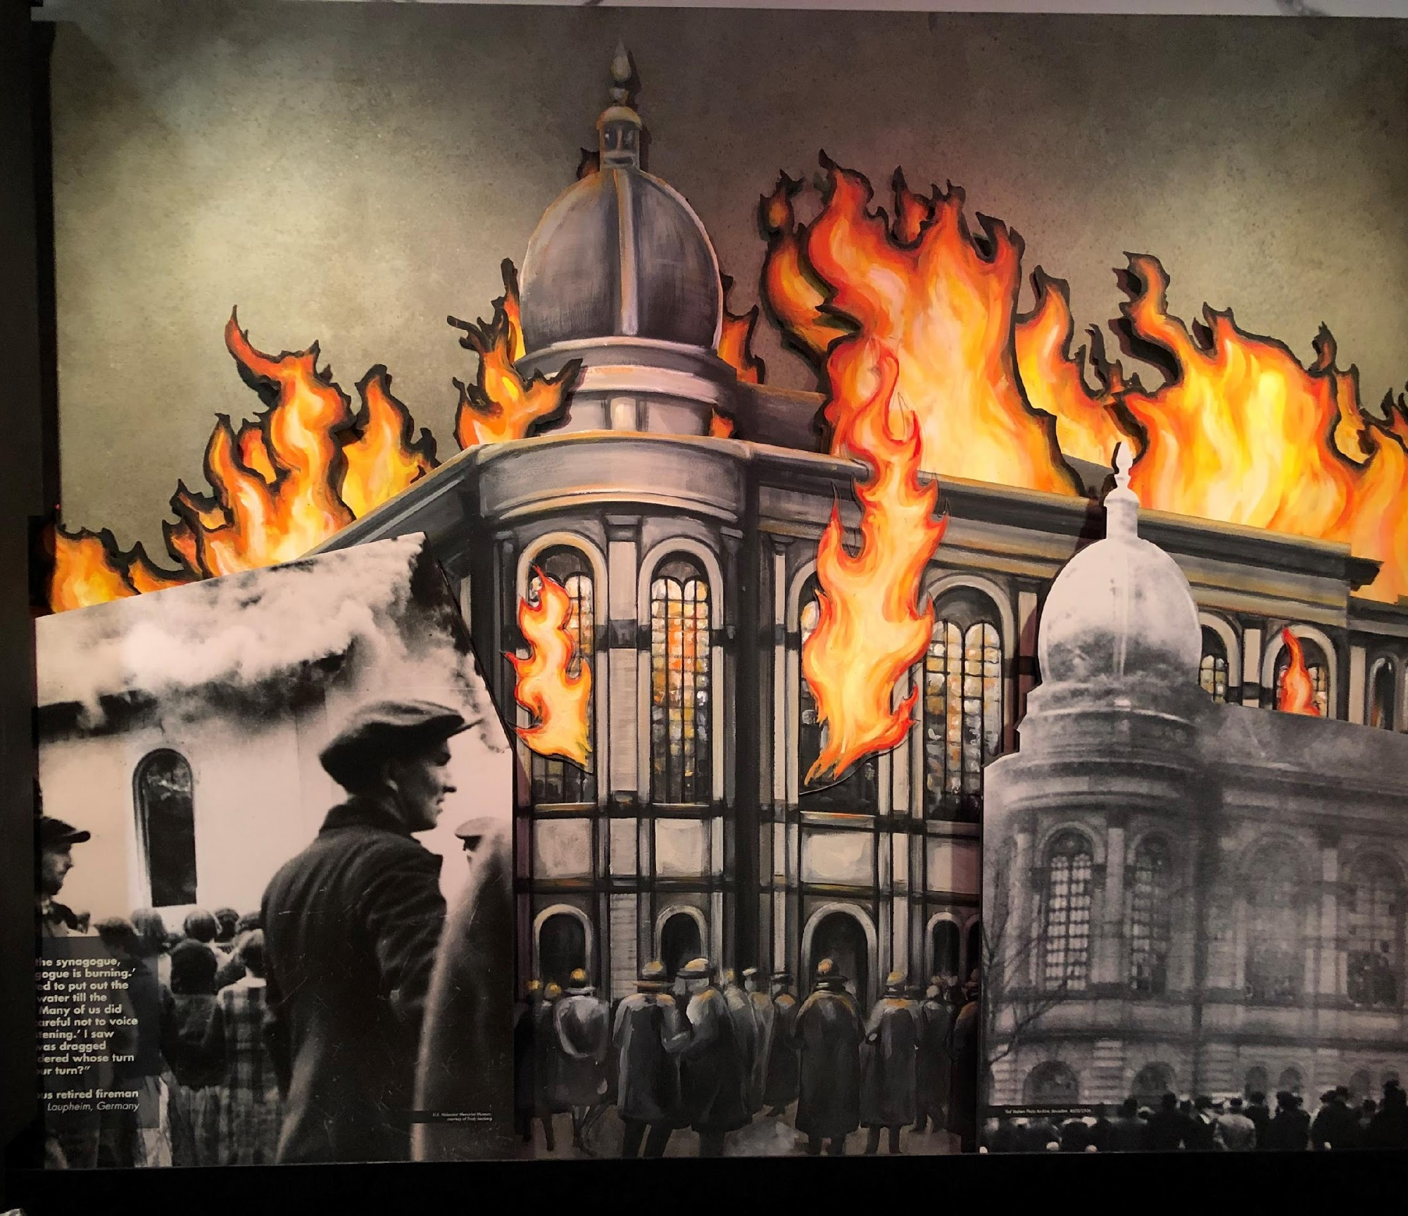
Violence
Watch the Tour Clip . What happened on Kristallnacht?
What decision did Frank Ephraim’s family make and why?
What did the Frieders, McNutt & Quezon decide to do?
Learn More: Kristallnacht

Slide 12
Escape
Watch the Tour Clip . What did you learn about the Philippines?
How were the Frieders, McNutt & Quezon able to help the Jews?
Where did the Cassels want to go before the Philippines? Why could they not go to those countries?
Learn More: Escape from German Occupied Europe

Slide 13
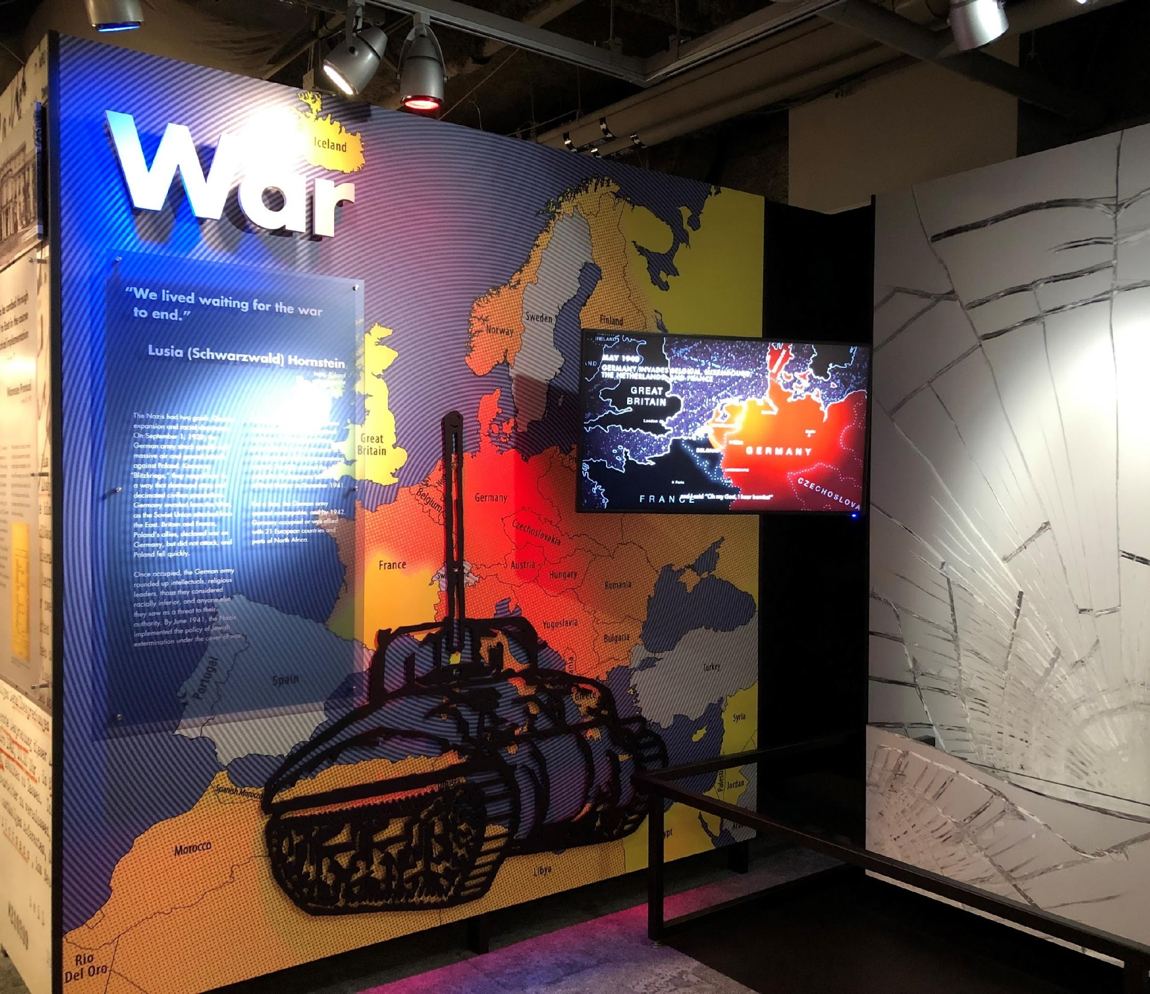
Escape during Wartime
Watch the Tour Clip . Why was escape nearly impossible in Europe in 1939?
What happen to the Frieders and Quezon?
Learn More: World War II in Europe

Slide 14
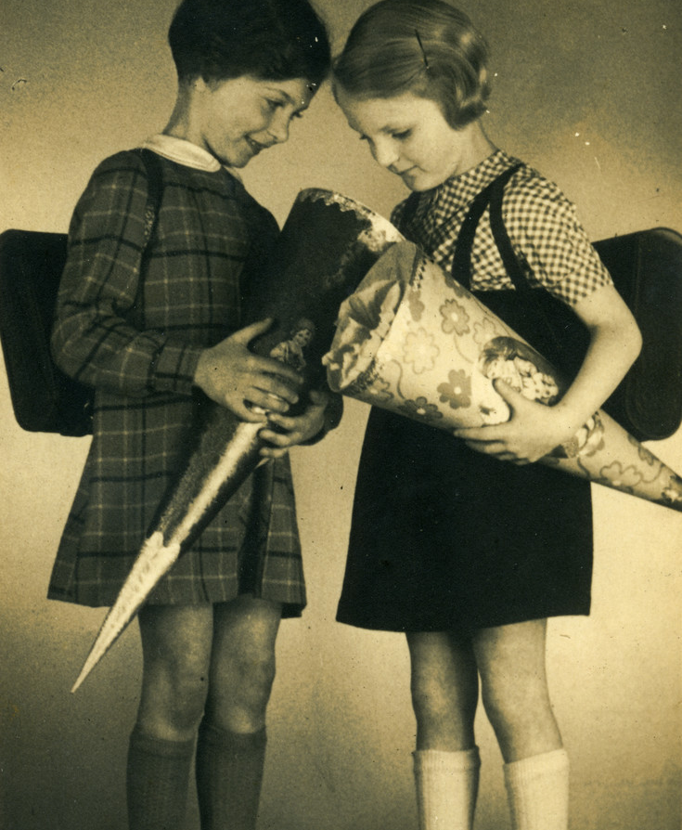
The Refugees
Learn More
Lotte Cassel Hershfield & Frank Ephraim were children when their families made their way to the Philippines. Both have shared their experiences. Frank is the author of the book Escape to Manila. You can Learn more about them by listening and watching their testimonies.
Frank Ephraim Audio
Lotte Hershfield Testimony
Photo. United States Holocaust Memorial Museum, courtesy of Margot Kestenbaum.
Margot and Lotte Cassel pose with their cones and backpacks on their first day of school.
Frank Ephraim

Slide 15
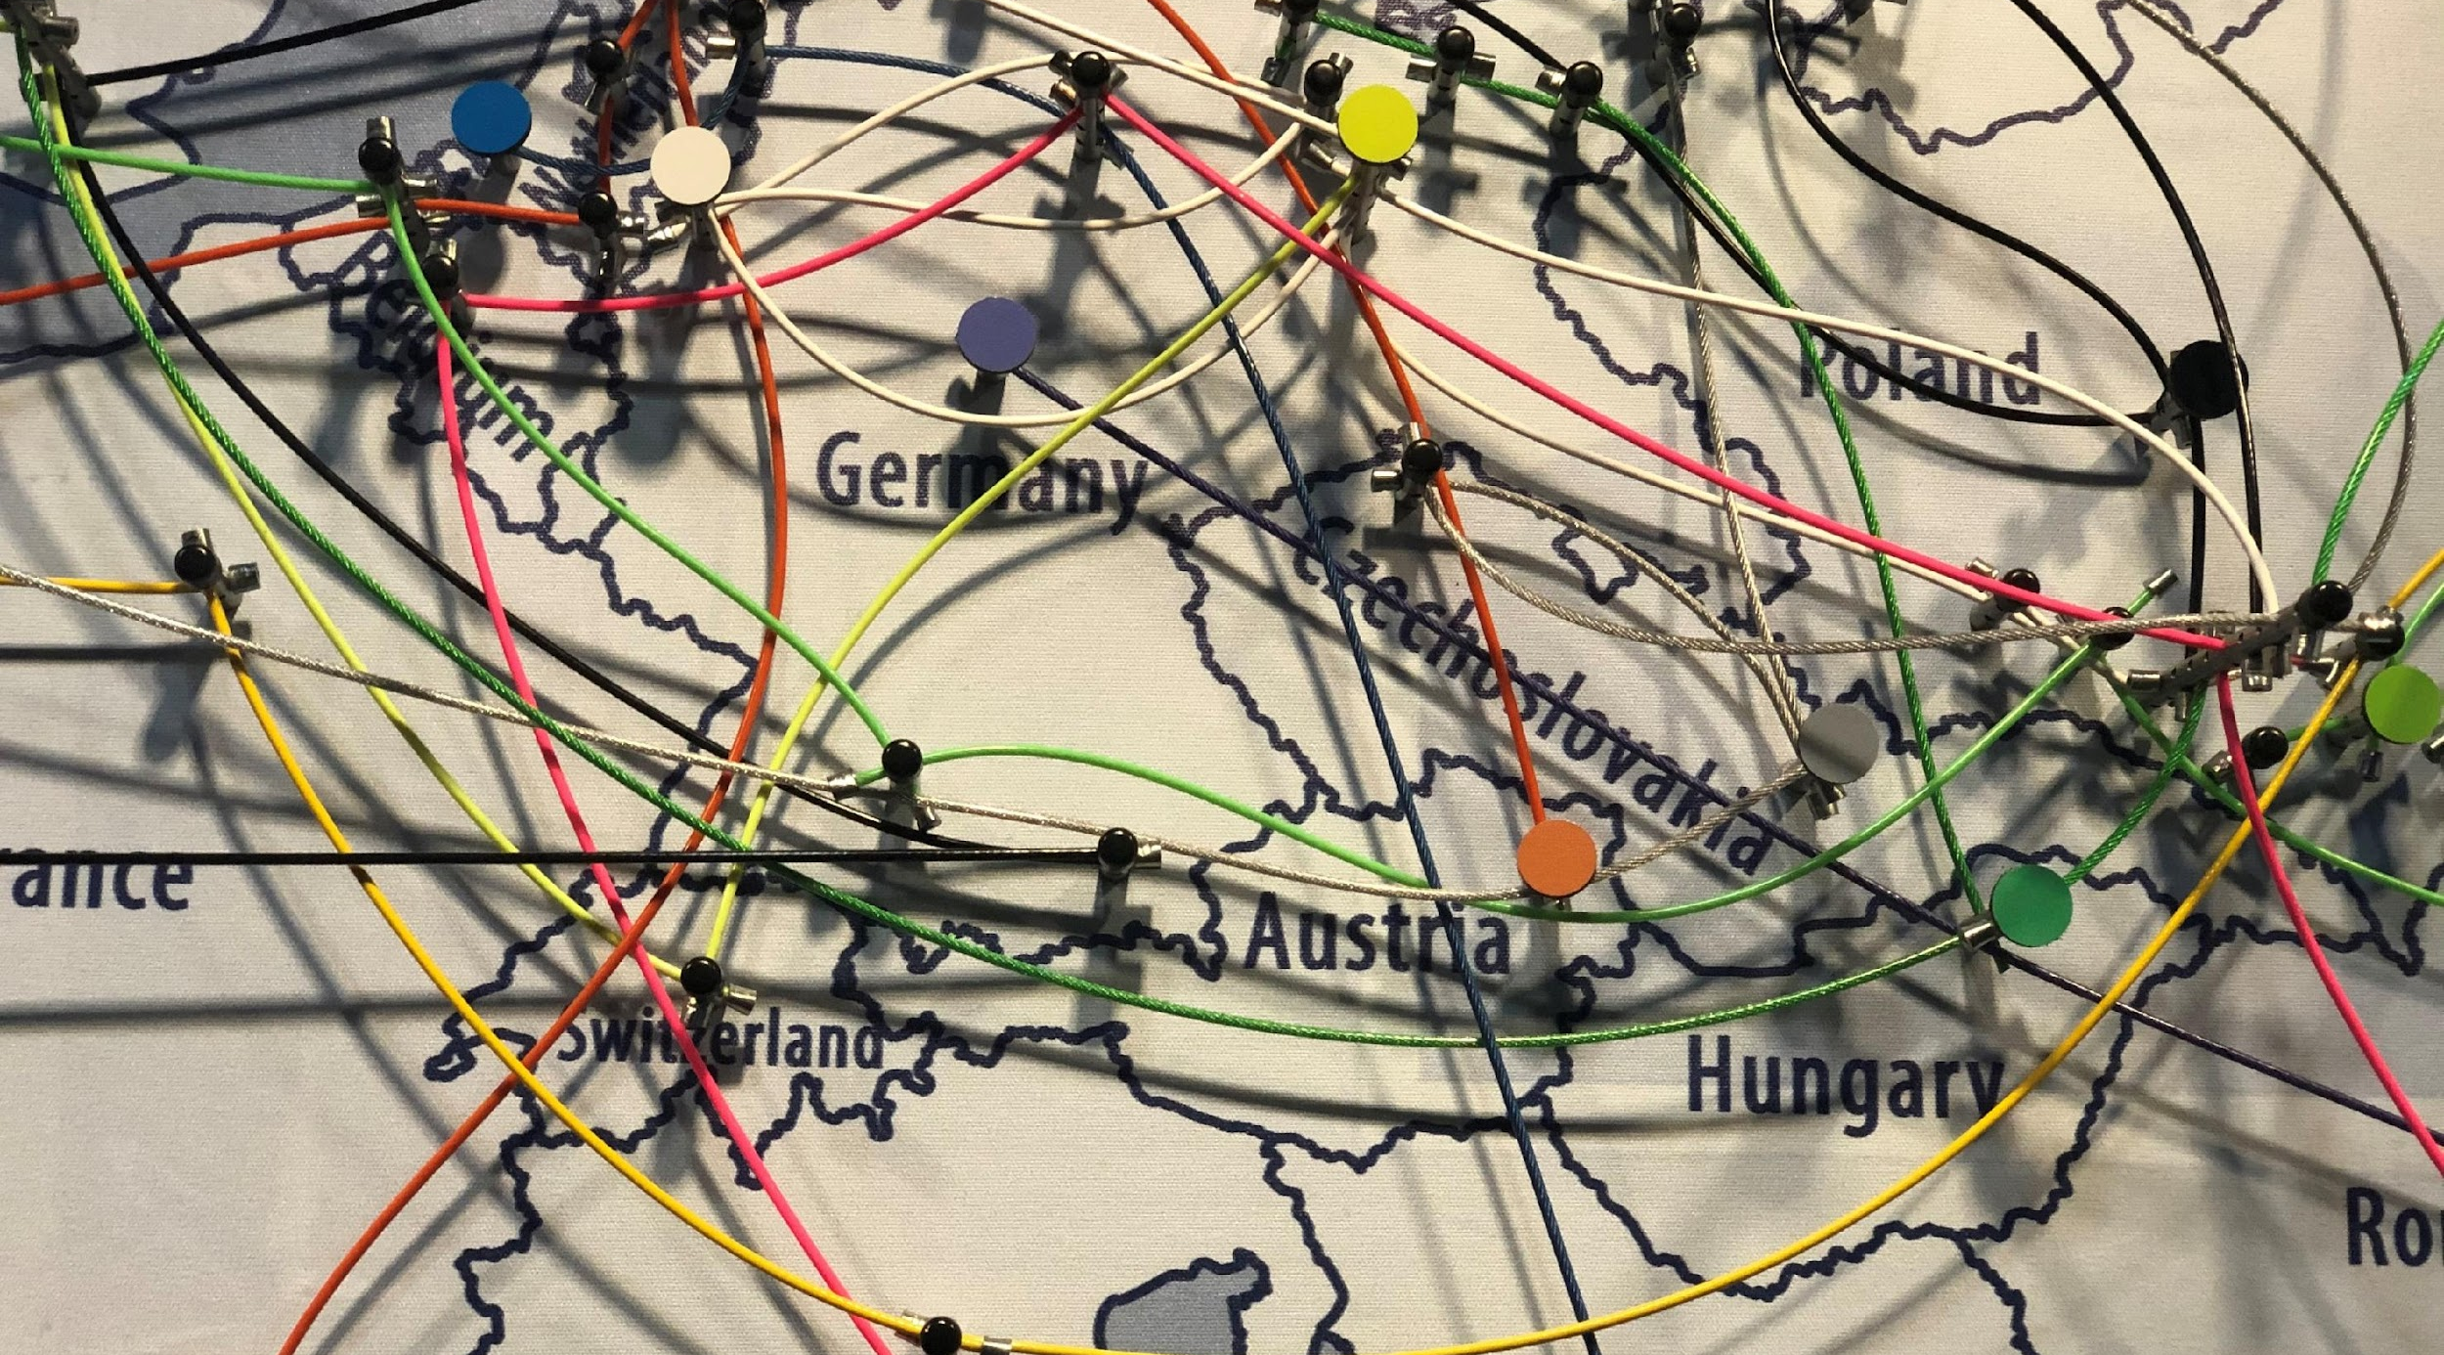
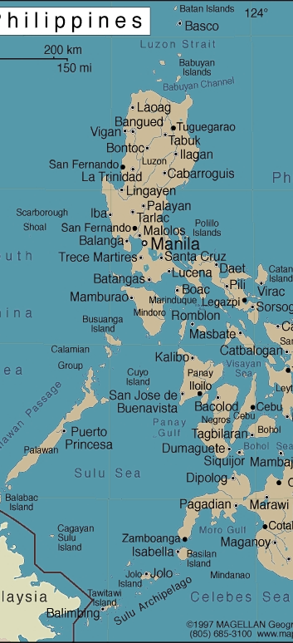
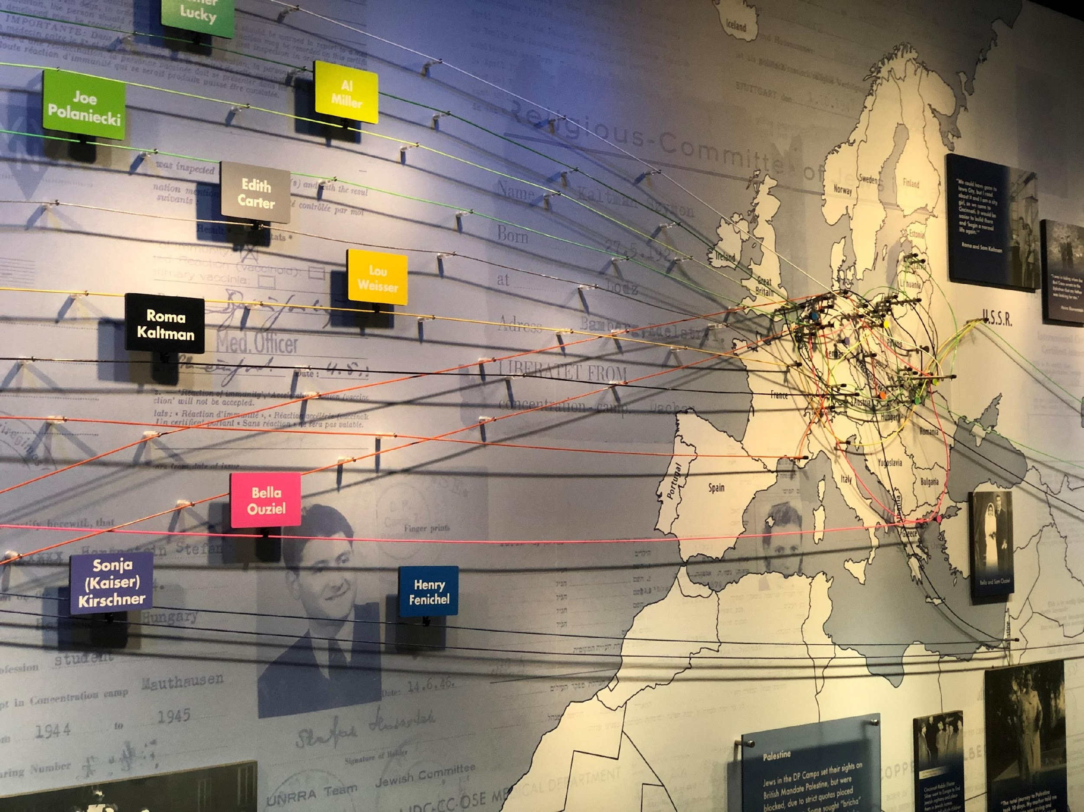
Refugees in Manilla
Watch the Tour clip & read the quote: “In Manila, my father was not a displaced person, he was a misplaced person.” (Lotte Cassell) What do you think Lotte’s father meant by this?
What happened to the refugees as the war went on?

Slide 16
Be an Upstander
Watch the Tour Clip. How did the Frieders, McNutt & Quezon fulfill Edith Carter’s message to us?
What is something that is important to you? How are you contributing to making change in your community?
How will you use your character strengths to make this change?

