Slide 1
The Story of Sala Waldman Werthaiser
Interactive Extension Activity

Slide 2
“Growing up, I was very close to my grandmother.”
Full video (You can view the full length 20-minute video-or choose to watch in segments by clicking on the clips.) You can begin by watching the Introduction Clip.
Melissa Hunter is a writer and author of the book What She Lost, which is a fictional account of her grandmother's life. Learn more about Melissa here.

Slide 3
Life Before the War
Watch the clip. What do we learn abut Sala’s family?
What about her life that resonated with you?
Watch the clip of Sala talking about her childhood. What does she say about her parents? Why did her mom always have water heating on the stove?

Slide 4
World War II
Watch the Clip. What happened to Sala’s brother?
How did the family hear about the war?
How did the lives of Sala and her family change?
Why is Bloody Wednesday significant?
Map. United States Holocaust Memorial Museum

Slide 5
Olkusz Ghetto
Watch the clip. What were conditions like in the ghetto?
Watch the clip of Sala. What did she do to help her family?
What type of help did Sala receive, what was involved?
Jews moving into the Olkusz Ghetto. Photo credit: United States Holocaust Memorial Museum, courtesy of Rose Grinbaum Futter

Slide 6
Deportation
Watch the clip. What happened to Sala and her family during the round-ups and deportations?
While Sala says that she could see the smokestacks of Auschwitz from the ghetto, her town was too far away for this to have been possible. Despite this, why do you think she remembers it this way?
Deportation list from Olkusz

Slide 7
Concentration Camps
Watch the clip. How many camps was Sala in?
What type of forced labor did Sala do in the camps?
What did Sala say about forming relationships in the camps?
Map. U.S. Holocaust Memorial Museum

Slide 8
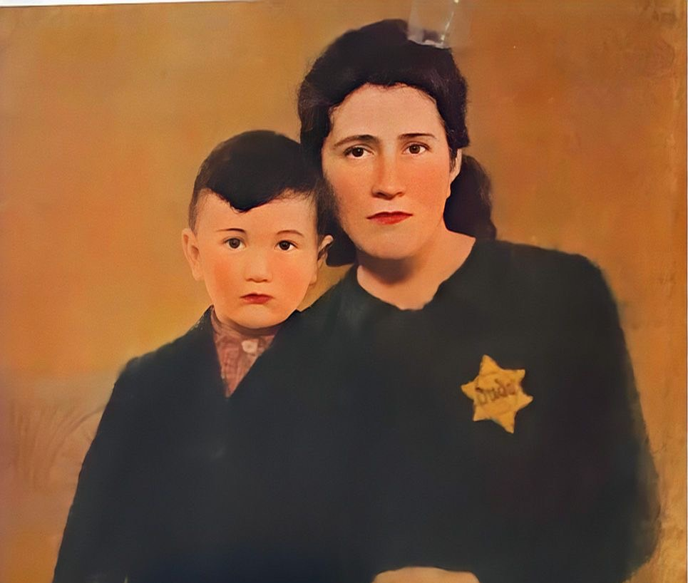
Liberation & Aftermath
Watch the liberation clip. What army liberated Sala, and what did she say about their treatment by that army?
Watch the aftermath clip. Where did Sala go after she was liberated?
Who did she find there, and who did she meet?
Watch the clip of Sala. How did she get to know her husband? Who married the couple?
Top: Harry, Sala & her brother Sam. Bottom: Harry’s first wife and son, who were killed.

Slide 9
Rebuilding
Watch the rebuilding clip. What date did Sala come to the United States? What does it tell you about the immigration process after the war?
Who sponsored Sala to come to the U.S.?
Watch the clip of Sala. What did Sala know about the United States, and why does she say she did not want to stay in Germany?

Slide 10
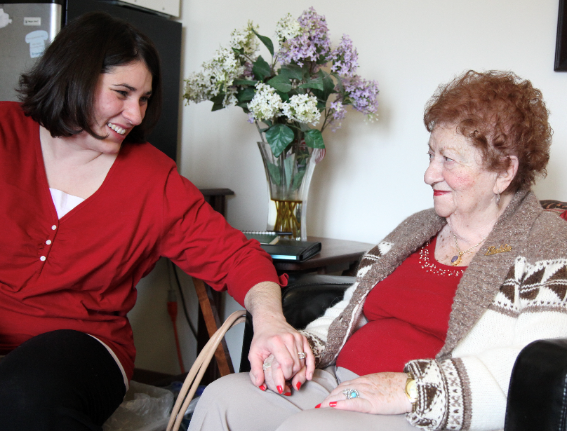
What She Lost
You just learned about the experiences of Sala Werthaiser from her granddaughter, Melissa Hunter.
Think about someone in your life that you are close to.
How would you tell their story?

