Slide 1
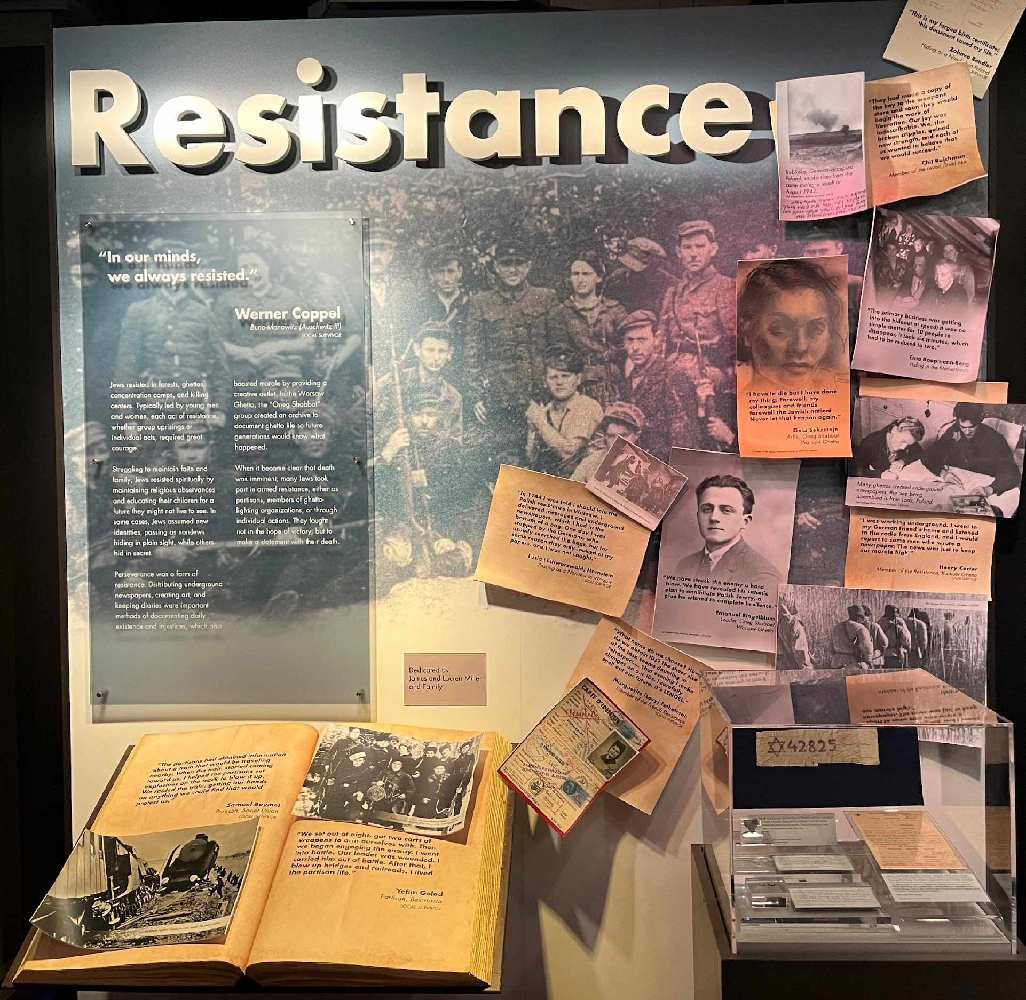
Breaking the Myth: How Jews Resisted During the Holocaust
An Inquiry Lesson

Slide 2
What is resistance?
Did Jews resist?
“The question is not why all the Jews did not fight, but how so many of them did. Tormented, beaten, starved, where did they find the strength spiritual and physical to resist?“
-Elie Wiesel, Holocaust survivor & author of Night
Bedřich Fritta, Commencement of Work, 1942/44
“In our minds, we always resisted.”
-Werner Coppel, local Holocaust survivor

Slide 3
How did Jews Resist?
Notes:
Left: A group of partisans from various fighting units including the Bielski group and escapees from the Mir Ghetto on guard duty at an airstrip in the Naliboki Forest. 1944 July. USHMM courtesy of Moshe Kaganovich. Right: Warsaw, Poland, Jews around a seder table in a shelter on 6 Leszno St. in the ghetto, reading from the Passover Haggada
Yad Vashem.

Slide 4
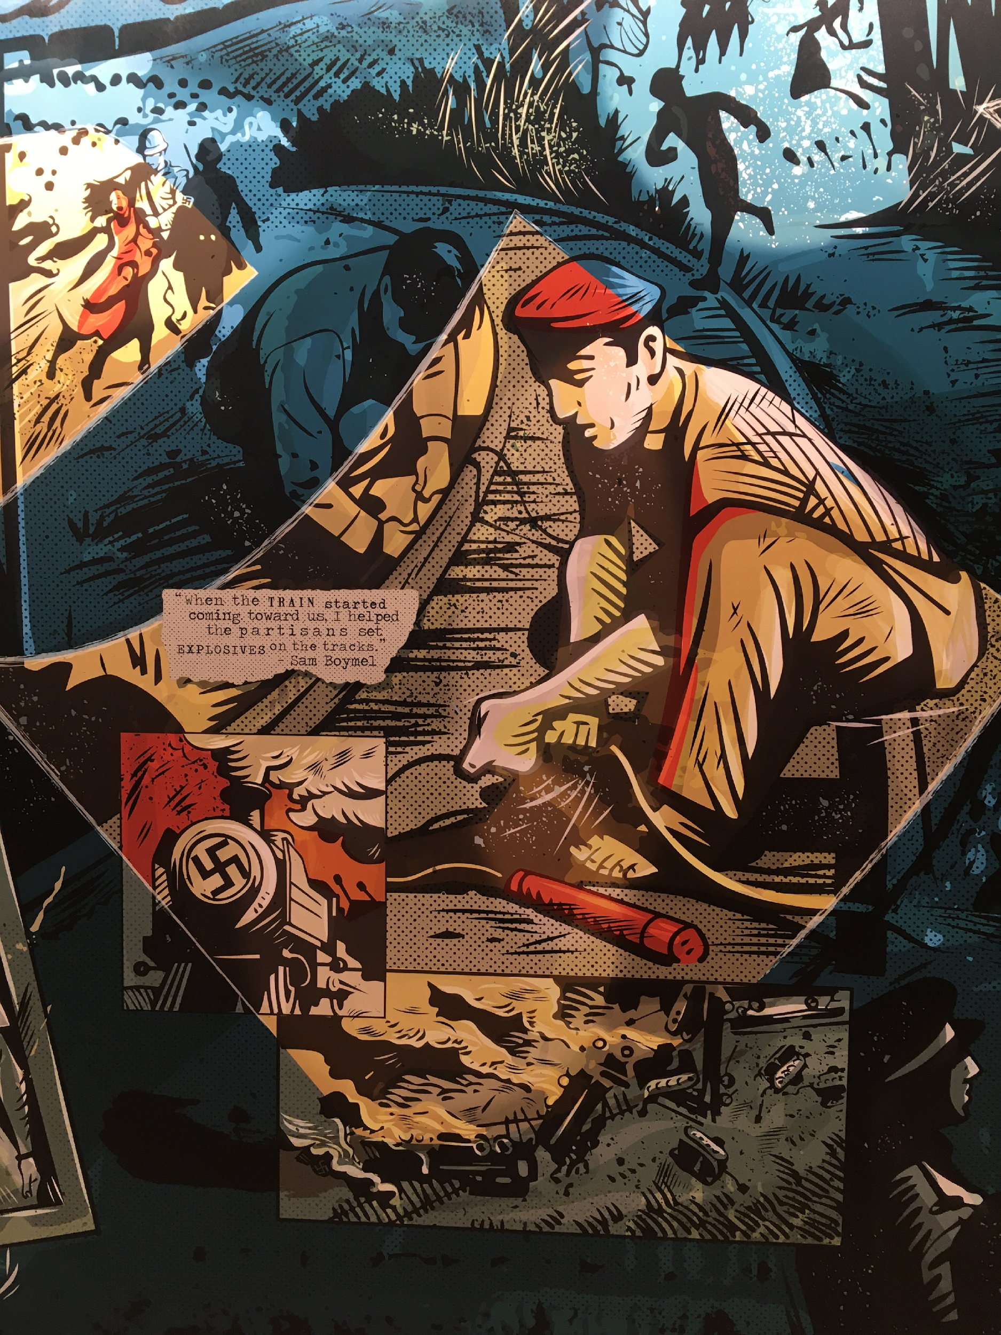
What is resistance?
Resistance comes in many forms, both violent and non-violent. There was armed resistance but also un-armed which included escape, hiding, cultural activity, and other acts of spiritual preservation.
In the scholar Yehuda Bauer’s view, resistance to the Nazis comprised not only physical opposition, but any activity that gave the Jewish people dignity and humanity in the most humiliating and inhumane conditions.

Slide 5
Brainstorm: What is Needed to Resist
Arms
Leaders
Health
Finances
Communication
Cooperation
Support
Notes:
Ask students to write down what is needed to resist?

Slide 6
Brainstorm: Obstacles to Resistance
Superior Power of the German Armed Forces
Collective Responsibility
Deception
Communication
Isolation
Policies
Notes:
Ask Students What are the obstacles to resistance?

Slide 7
The Chain of Resistance
“Armed resistance was possible because there was an ethical and moral resistance going on in the ghetto. It was a chain; it did not come suddenly. Young people came from houses that were full of hope, belief in humanity and justice, and this was the chain to active resistance.”
Vladka Meed (Feigele Peltel), Member of the Warsaw Ghetto Resistance
Notes:
False identification card which Vladka Meed had used from 1940–42 on the Aryan side of Warsaw, smuggling arms to Jewish fighters and helping Jews escape from the ghetto.
US Holocaust Memorial Museum, courtesy of Benjamin (Miedzyrzecki) Meed

Slide 8
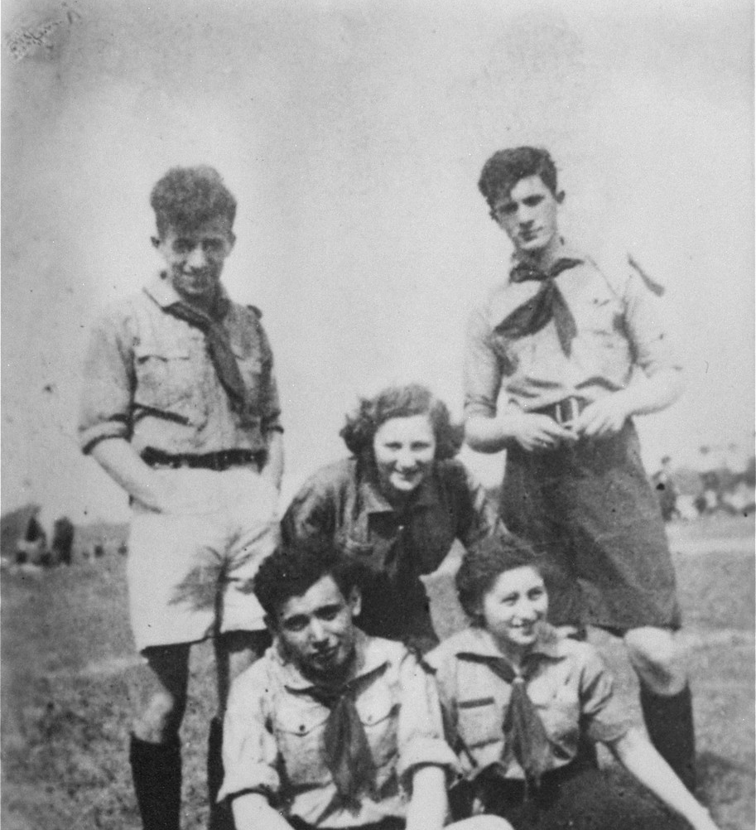
Why Resist?
Notes:
The Nazi’s Final Solution was to exterminate all the Jews of Europe. It was known in the Warsaw Ghetto that no matter what they did, they most likely would not overcome the German Army or survive. So why resist?
About Mordecai Anielewicz (1919-1943): Anielewicz was commander of the Zydowska Organizacja Bojowa [Jewish Fighting Organization, ZOB] from November 1942, and one of the leaders of the ghetto uprisings in January and April 1943. Anielewicz was killed in a bunker, with other leaders of the ZOB, in May 1943. He was raised in what Vladka Meed refers to as the chain of resistance.
Photo on the right: (he is the one standing in back on the right) the photo is a group portrait of members of the Hashomer Hatzair socialist Zionist youth movement in 1938. United States Holocaust Memorial Museum, courtesy of Leah Hammerstein Silverstein.

Slide 9
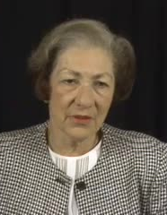
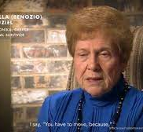
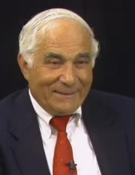
Testimony
Watch the videos of four local Holocaust survivors explaining how they resisted during the Holocaust. Use the survivor bios and testimonies to fill in the graphic organizer.

Slide 10
1. Sam Boymel
Before you watch Sam’s testimony, read his bio and fill in the first two boxes on your graphic organizer.
Then, watch his video testimony and fill in the final two boxes on your graphic organizer.
Notes:
video clip: https://vimeo.com/manage/videos/759259180/32f7daf7ae

Slide 11
Notes:
Map of Partisan activity. USHMM Sam Boymel was in Ukrainian Territory.

Slide 12
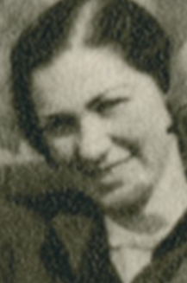
“It was all about survival. Every day another decree. Things got worse all the time. Germans and Ukrainians in uniform were in front of our house. We could hear but not see shooting and screaming all day long.”
Lusia (Schwarzwald) Hornstein, Lwow Ghetto
Notes:
Lusia Hornstein

Slide 13
Notes:
Lusia Hornstein took part of the Warsaw Uprising of August 1944. She arrived in Warsaw after the Ghetto Uprising of April-May 1943. She hid in Warsaw as a non-Jewish Pole and was part of the Polish Underground Resistance.

Slide 14
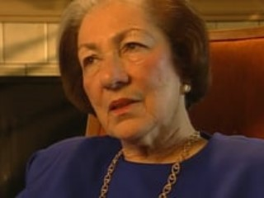
2. Lusia (Schwarzwald) Hornstein
Before you watch Lusia’s testimony, read her bio and fill in the first two boxes on your graphic organizer.
Then, watch her video testimony and fill in the final two boxes on your graphic organizer. 🡪
Follow along with the video transcript, if needed.
Notes:
video clip: https://vimeo.com/manage/videos/755583367/00d57fbd77
Lusia was part of the Polish Resistance in Warsaw- hiding with false papers.

Slide 15
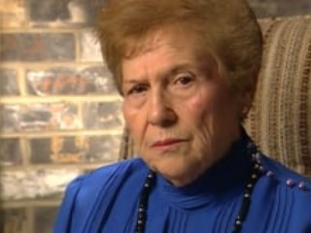
3. Bella Ouziel
Before you watch Bella’s testimony, read her bio and fill in the first two boxes on your graphic organizer.
Then, watch her video testimony and fill in the final two boxes on your graphic organizer. 🡪
Follow along with the video transcript, if needed.
Notes:
video clip: https://vimeo.com/manage/videos/755590199/037893ab4c/privacy
Bella Ouziel is in Auschwitz with a group of women who kept the fast on Yom Kippur.

Slide 16
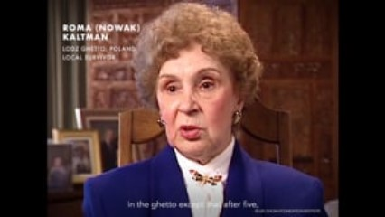
4. Roma Kaltman
Before you watch Roma’s testimony, read her bio and fill in the first two boxes on your graphic organizer.
Then, watch her video testimony and fill in the final two boxes on your graphic organizer. 🡪
Follow along with the video transcript, if needed.
Notes:
video clip: https://vimeo.com/368288660/f29a1d310a
Roma Nowak was in the Lodz Ghetto. The story her is of one retaining one’s humanity.

Slide 17
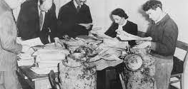
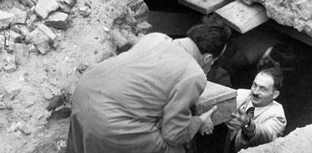
Summary Question
Answer the summary question on your worksheet and be prepared to discuss it.
Notes:
Photos are of the retrieval of the hidden “Oneg Shabbat” archive after the war. The movement in the Warsaw Ghetto was created to document what was taking place in the ghetto and to preserve the history of the persecution of the Jews by the Nazis.

Slide 18
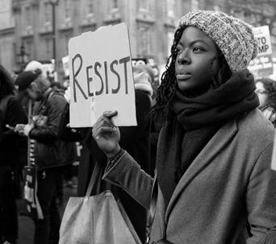
Current Day Connections
Resistance comes in many forms.
Why is it important that we study the example of Jewish Resistance during the Holocaust?
Where do you see acts of resistance in the United States and around the world today?

